Slide 1
Lesson plans for Genesis 6-8, 11
Antonio Chaves

Slide 2
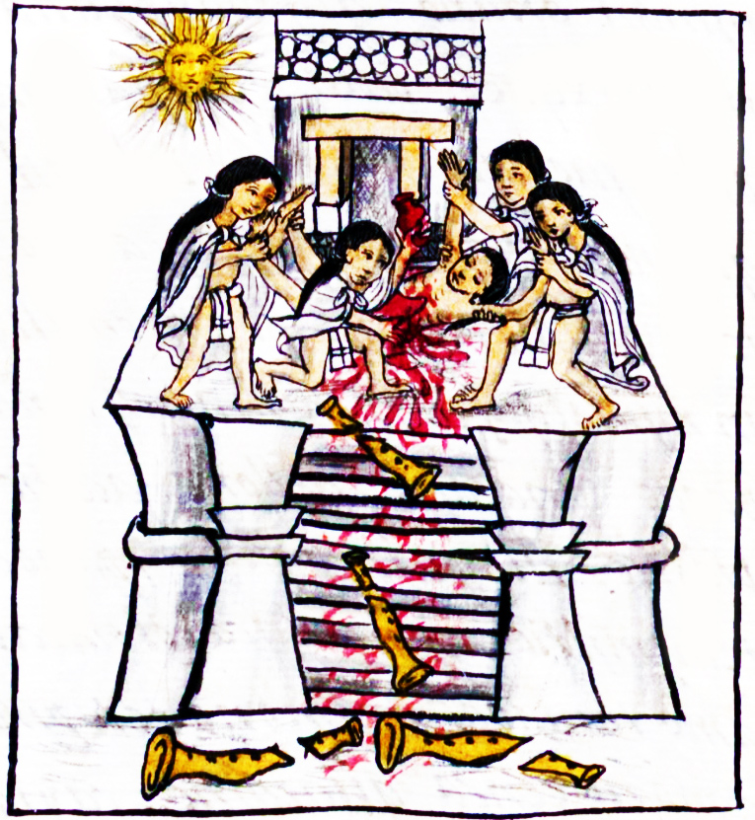
Genesis 6: 5-8
⁵Yahweh saw that the wickedness of man was great in the earth, and that every imagination of the thoughts of man’s heart was continually only evil. ⁶Yahweh was sorry that he had made man on the earth and it grieved him in his heart.
⁷Yahweh said, “I will destroy man whom I have created from the surface of the ground—man, along with animals, creeping things, and birds of the sky—for I am sorry that I have made them.”
⁸But Noah found favor in Yahweh’s eyes.

Slide 3
Questions
Was it right for God to drown so many people?
Was it right for God to drown so many animals?

Slide 4
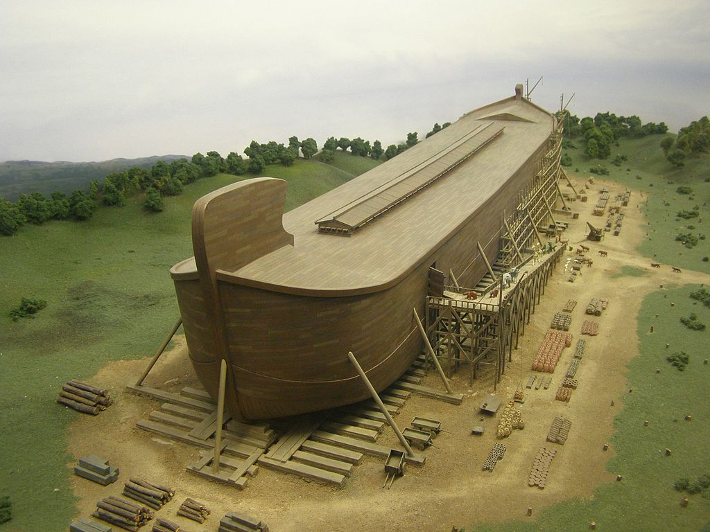
Genesis 6: 9, 13, 22
⁹This is the history of the generations of Noah: Noah was a righteous man, blameless among the people of his time. Noah walked with God.… ¹³God said to Noah, “I will bring an end to all flesh, for the earth is filled with violence through them. Behold, I will destroy them and the earth. ¹⁴Make a ship of gopher wood. You shall make rooms in the ship, and shall seal it inside and outside with pitch…
²²Thus Noah did. He did all that God commanded him.

Slide 5
Questions
What is the significance of the passage: Noah was…blameless among the people of his time? Why is this context so important?

Slide 6
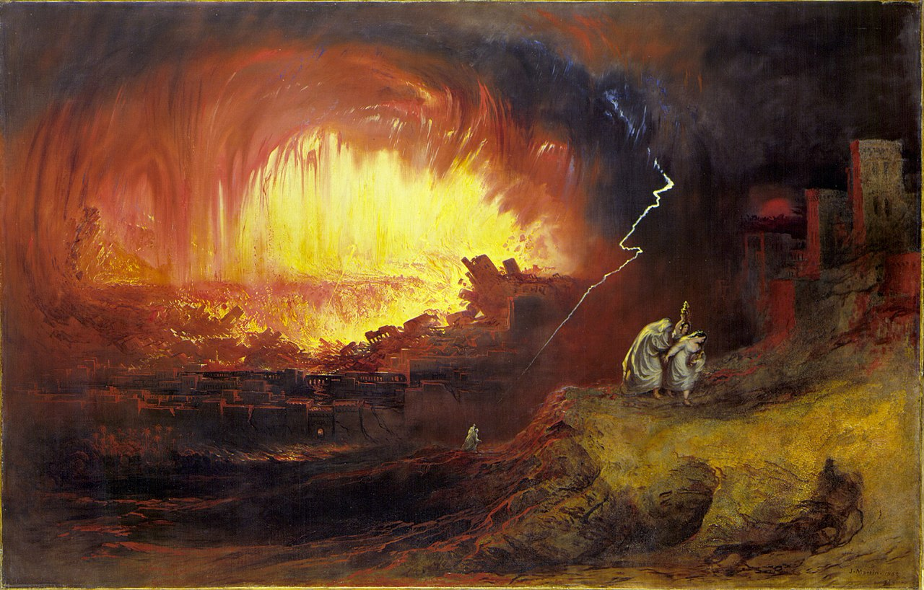
Genesis 18: 20-24
²⁰Yahweh said, “Because the cry of Sodom and Gomorrah is great, and because their sin is very grievous, ²¹I will go down now, and see whether their deeds are as bad as the reports which have come to me. If not, I will know.”
²²The men turned from there, and went toward Sodom, but Abraham stood yet before Yahweh. ²³Abraham came near, and said, “Will you consume the righteous with the wicked? ²⁴What if there are fifty righteous within the city? Will you consume and not spare the place for the fifty righteous who are in it?

Slide 7
Questions
Contrast Noah and Abraham’s responses to God when He makes His plans known to each of them. How are they different?
How does this relate to their future roles in God’s plan?

Slide 8
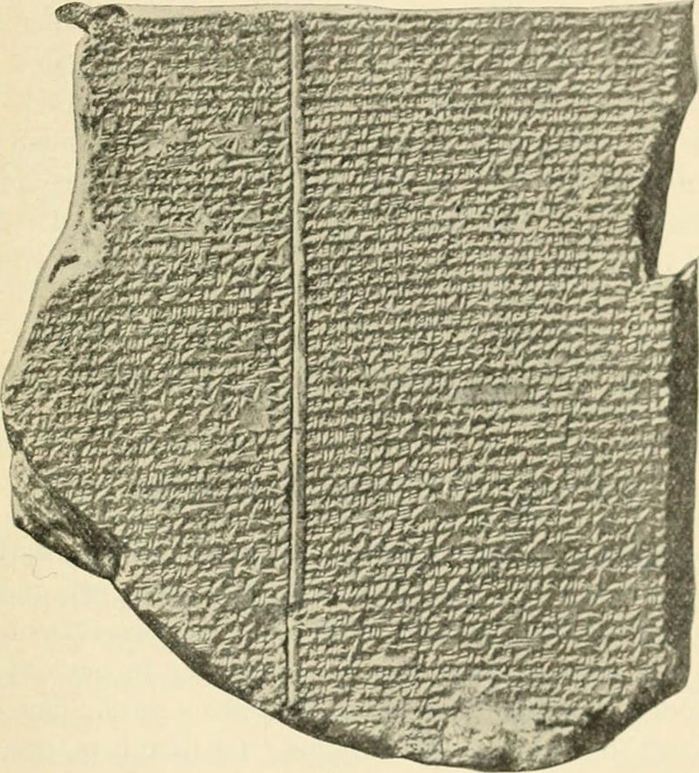
Verses from the Gilgamesh flood story
…The gods were frightened by the flood, and retreated, ascending to the heaven of Anu.
The gods were cowering like dogs, crouching by the outer wall.
Downloaded from The Epic of Gilgamesh:
http://www.ancienttexts.org/library/mesopotamian/gilgamesh/tab11.htm

Slide 9
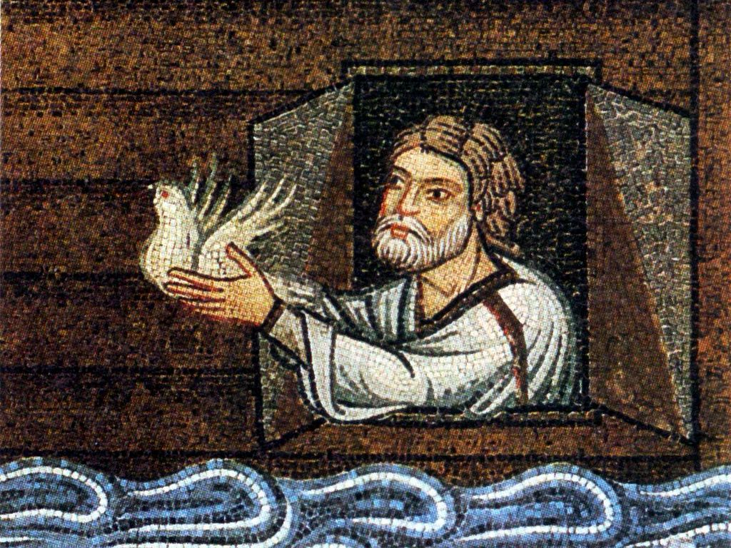
Genesis 8: 1-3
¹God remembered Noah, and all the livestock that were with him in the ship; and God made a wind to pass over the earth. The waters subsided. ²The deep’s fountains and the sky’s windows were also stopped, and the rain from the sky was restrained. ³The waters continually receded from the earth. After the end of one hundred fifty days the waters receded.

Slide 10
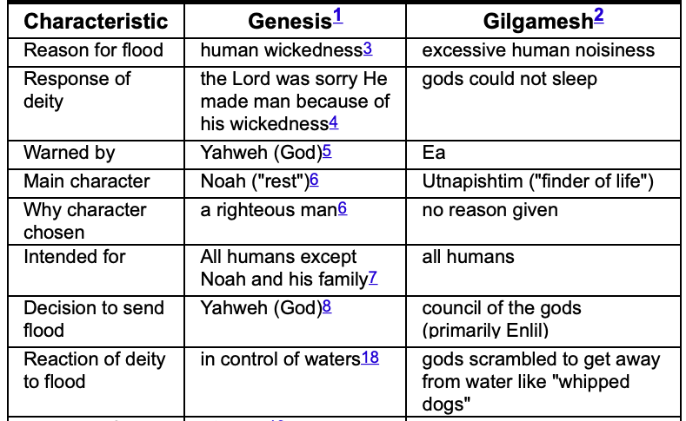
Bible flood versus the sumerian flood
Screenshot from: https://www.godandscience.org/apologetics/gilgamesh.html

Slide 11
Questions
How does God’s response to the flood differ from that of the Sumerian deities?
What other differences make the Genesis account more meaningful to our lives?

Slide 12
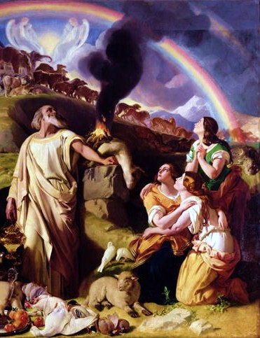
Genesis 8: 18-22
¹⁸Noah went out, with his sons, his wife, and his sons’ wives with him. ¹⁹Every animal, every creeping thing, and every bird, whatever moves on the earth, after their families, went out of the ship.
²⁰Noah built an altar to Yahweh, and took of every clean animal, and of every clean bird, and offered burnt offerings on the altar. ²¹Yahweh smelled the pleasant aroma. Yahweh said in his heart, “I will not again curse the ground any more for man’s sake because the imagination of man’s heart is evil from his youth. I will never again strike every living thing, as I have done. ²²While the earth remains, seed time and harvest, and cold and heat, and summer and winter, and day and night will not cease.”

Slide 13
Questions
What five covenants did God establish with mankind?
Why are these covenants necessary? Why is conscience alone never enough to guide mankind?
Why do so many people today believe that conscience alone is enough for guiding mankind?

Slide 14
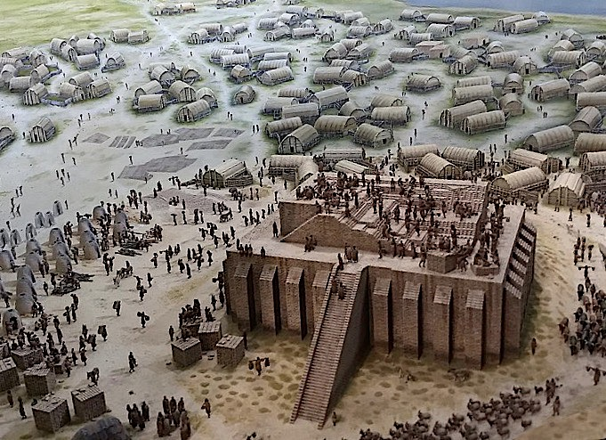
Genesis 11: 1-4
¹The whole earth was of one language and of one speech. ²As they traveled east, they found a plain in the land of Shinar, and they lived there. ³They said to one another, “Come, let’s make bricks, and burn them thoroughly.” They had brick for stone, and they used tar for mortar. ⁴They said, “Come, let’s build ourselves a city, and a tower whose top reaches to the sky, and let’s make a name for ourselves, lest we be scattered abroad on the surface of the whole earth.”

Slide 15
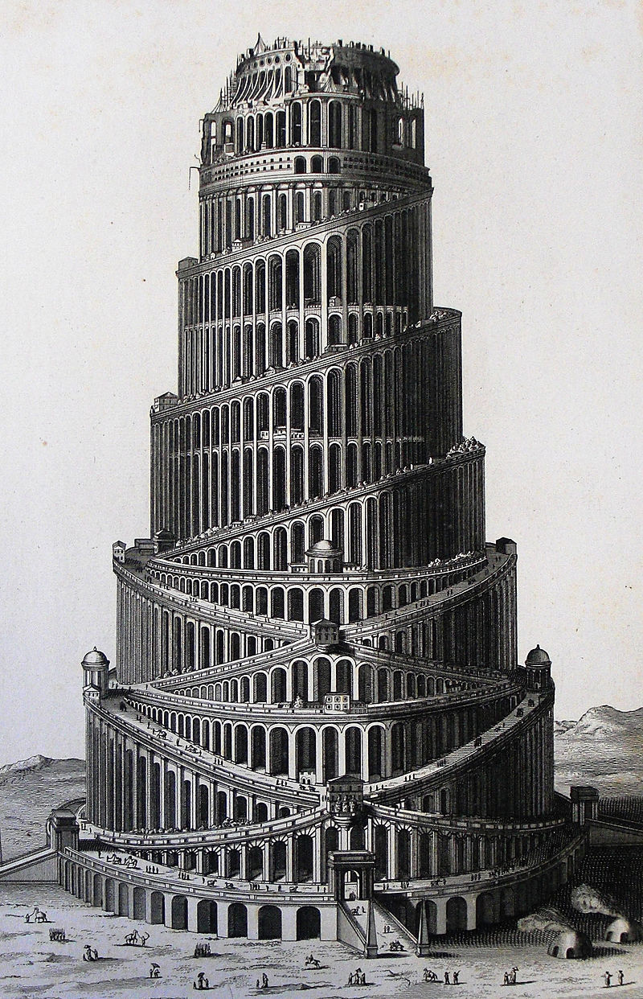
Genesis 11: 5-6
⁵Yahweh came down to see the city and the tower which the children of men built. ⁶Yahweh said, “Behold, they are one people, and they all have one language, and this is what they begin to do will be withheld from them.

Slide 16
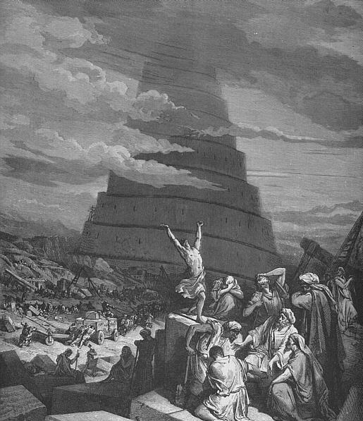
Genesis 11: 7-9
⁷Come, let’s go down and there confuse their language, that they may not understand one another’s speech.” ⁸So Yahweh scattered them abroad from there on the surface of all the earth. They stopped building the city. ⁹Therefore its name was called Babel, because there Yahweh confused the language of all the earth. From there Yahweh scattered them abroad on the surface of all the earth.

Slide 17
Questions
Why did they choose to build this city and tower? What would they have gotten out of it?
What are the moral hazards of concentrating too much power and prestige in one location?
What are the moral hazards of science and technology in the absence of God-centeredness?

Slide 18
Acknowledgments:
Scripture verses were taken from the World English Bible and edited for clarity.
Unless otherwise indicated, all images were downloaded from Wikimedia.
Most of the questions are derived from commentary from “The Rational Bible: Genesis” by Dennis Prager.

