Slide 1
Lesson plans for Genesis 44-50
Antonio Chaves

Slide 2
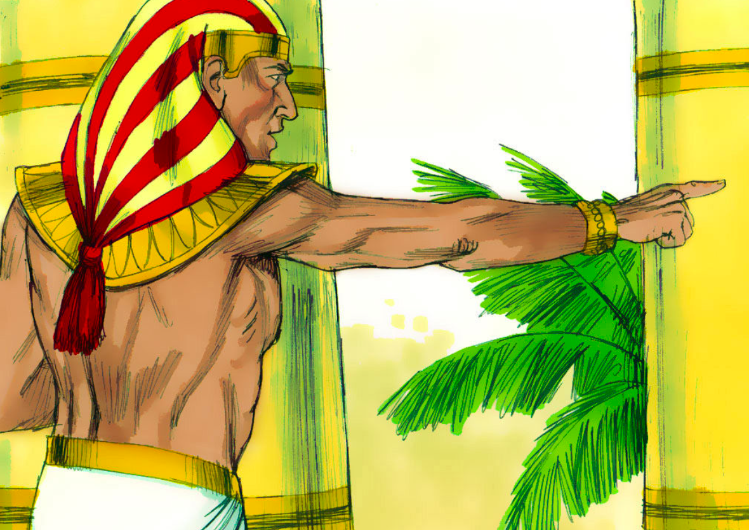
Genesis 44: 14-17
¹⁴Judah and his brothers came to Joseph’s house and he was still there. They fell on the ground before him. ¹⁵Joseph said to them, “What deed is this that you have done? Don’t you know that such a man as I can indeed do divination?”
¹⁶Judah said, “What will we tell my lord? What will we speak? How will we clear ourselves? God has found out the iniquity of your servants. Behold, we are my lord’s slaves, both we and he also in whose hand the cup is found.”
Downloaded from FreeBibleimages.org
¹⁷He said, “Far be it from me that I should do so. The man in whose hand the cup is found, he will be my slave; but as for you, go up in peace to your father.”

Slide 3
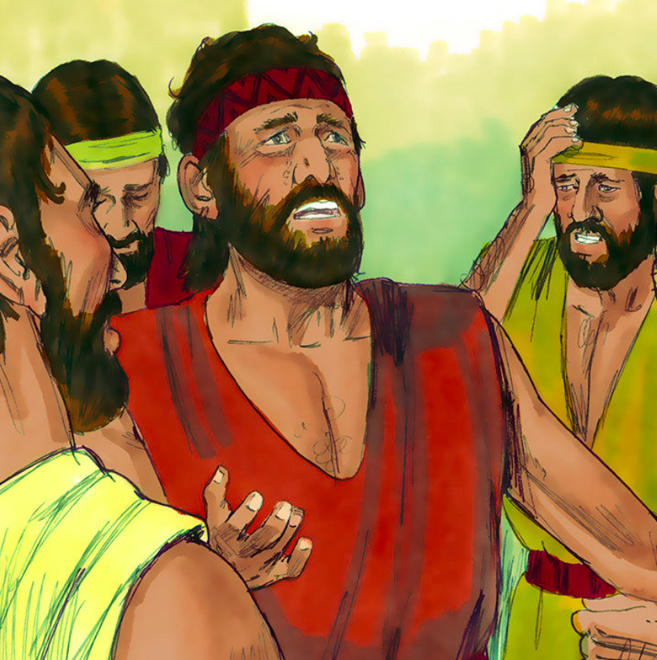
Genesis 44: 18, 27-30, 33-34
¹⁸Then Judah came near to him, and said “Oh, my lord, please let your servant speak a word in my lord’s ears, and don’t let your anger burn against your servant; for you are even as Pharaoh... ²⁷Your servant, my father, said to us, ‘You know that my wife bore me two sons. ²⁸One went out from me, and I said, “Surely he is torn in pieces;” and I haven’t seen him since. ²⁹If you take this one also from me, and harm happens to him, you will bring down my gray hairs with sorrow. ³⁰Now therefore when I come to your servant my father, and the boy is not with us; since his life is bound up in the boy’s life…
³³Now therefore, please let your servant stay instead of the boy, my lord’s slave; and let the boy go up with his brothers. ³⁴For how will I go up to my father, if the boy isn’t with me?—lest I see the evil that will come on my father.”
Downloaded from FreeBibleimages.org

Slide 4
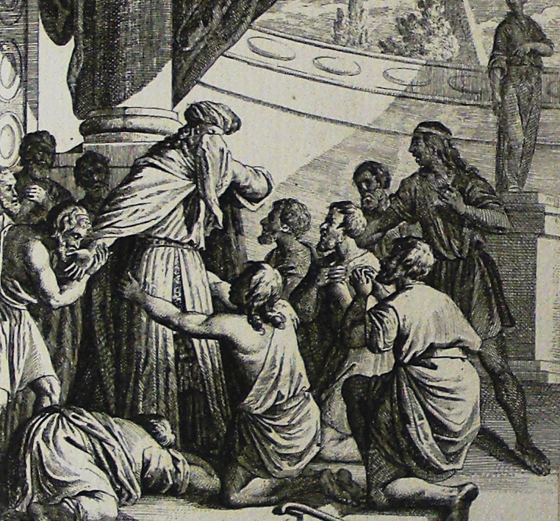
Genesis 45: 1-7
¹Then Joseph couldn’t control himself before all those who stood before him and he called out, “Cause everyone to go out from me!” No one else stood with him while Joseph made himself known to his brothers. ²He wept aloud. The Egyptians heard and the house of Pharaoh heard. ³Joseph said to his brothers, “I am Joseph! Does my father still live?”
His brothers couldn’t answer him; for they were terrified at his presence. ⁴Joseph said to his brothers, “Come near to me, please.”
They came near. He said, “I am Joseph, your brother, whom you sold into Egypt. ⁵Now don’t be grieved nor angry with yourselves that you sold me here, for God sent me before you to preserve life. ⁶For these two years the famine has been in the land, and there are yet five years in which there will be no plowing and no harvest. ⁷God sent me before you to preserve for you a remnant in the earth, and to save you alive by a great deliverance.

Slide 5
Questions
What moved Joseph to finally reveal himself to his brothers?
What convinced Joseph that his brothers had fully repented for their crime?
Which brother’s idea was it to sell Joseph into slavery?
How did Joseph reassure his brothers that he had forgiven them?

Slide 6
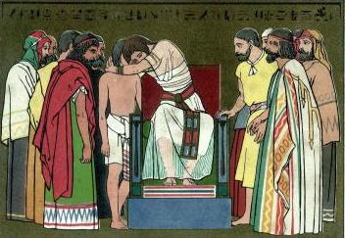
Genesis 45: 8-15
⁸So now it wasn’t you who sent me here, but God, and he has made me a father to Pharaoh, lord of all his house, and ruler over all the land of Egypt. ⁹Hurry and go up to my father and tell him, ‘This is what your son Joseph says, “God has made me lord of all Egypt. Come down to me. Don’t wait. ¹⁰You shall dwell in the land of Goshen and you will be near to me, you, your children, your children’s children, your flocks, your herds, and all that you have. ¹¹There I will provide for you; for there are yet five years of famine; lest you come to poverty.”’ ¹²Behold, your eyes see, and the eyes of my brother Benjamin, that it is my mouth that speaks to you. ¹³You shall tell my father of all my glory in Egypt, and of all that you have seen. You shall hurry and bring my father down here.” ¹⁴He fell on his brother Benjamin’s neck and wept, and Benjamin wept on his neck. ¹⁵He kissed all his brothers, and wept on them. After that his brothers talked with him.

Slide 7
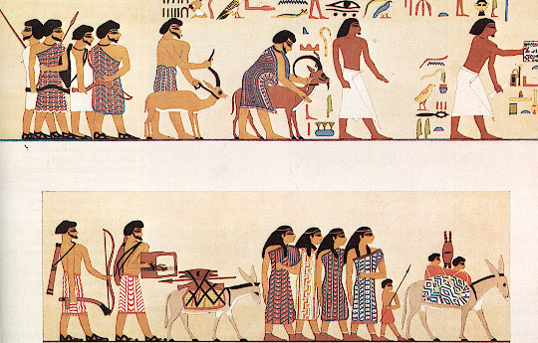
Genesis 45: 16-23
¹⁶The report of it was heard in Pharaoh’s house, saying, “Joseph’s brothers have come.” It pleased Pharaoh well, and his servants. ¹⁷Pharaoh said to Joseph, “Tell your brothers, ‘Do this: Load your animals, and go, travel to the land of Canaan. ¹⁸Take your father and your households, and come to me, and I will give you the good of the land of Egypt, and you will eat the fat of the land.’ ¹⁹Now you are commanded to do this: Take wagons out of the land of Egypt for your little ones, and for your wives, and bring your father, and come. ²⁰Also, don’t concern yourselves about your belongings, for the good of all the land of Egypt is yours.”
²¹The sons of Israel did so. Joseph gave them wagons, according to the commandment of Pharaoh, and gave them provision for the way. ²²He gave each one of them changes of clothing, but to Benjamin he gave three hundred pieces of silver and five changes of clothing. ²³He sent the following to his father: ten donkeys loaded with the good things of Egypt, and ten female donkeys loaded with grain and bread and provision for his father by the way.

Slide 8
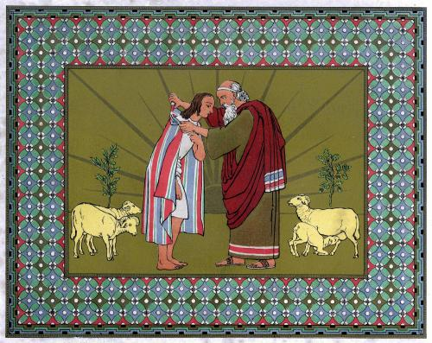
Genesis 45: 24-28
²⁵They went up out of Egypt, and came into the land of Canaan, to Jacob their father. ²⁶They told him, saying, “Joseph is still alive and he is ruler over all the land of Egypt.” His heart fainted, for he didn’t believe them. ²⁷They told him all the words of Joseph, which he had said to them. When he saw the wagons which Joseph had sent to carry him, the spirit of Jacob, their father, revived. ²⁸Israel said, “It is enough. Joseph my son is still alive. I will go and see him before I die.”

Slide 9
Questions
Why was the Pharaoh so generous towards Jacob’s family?
What convinced Jacob that Joseph was still alive?

Slide 10
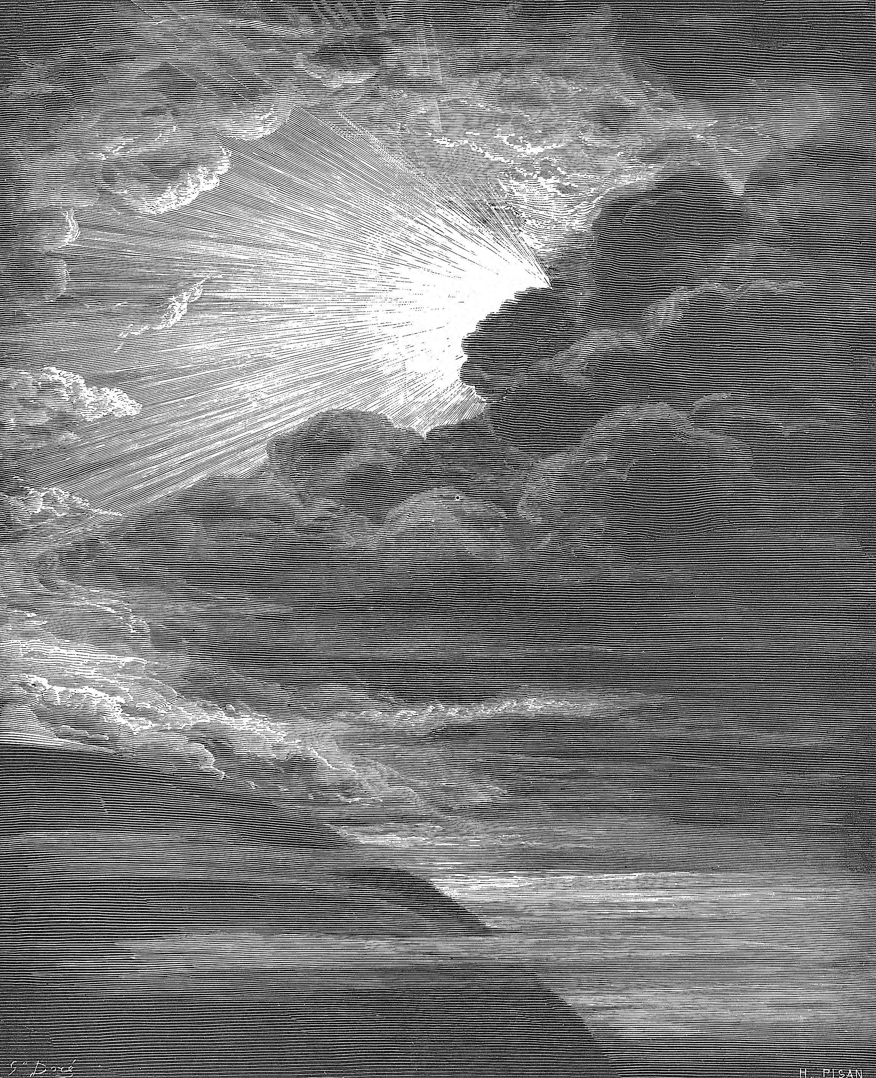
Genesis 46: 2-6
²God spoke to Israel in the visions of the night, and said, “Jacob, Jacob!”
He said, “Here I am.”
³He said, “I am God, the God of your father. Don’t be afraid to go down into Egypt, for there I will make of you a great nation. ⁴I will go down with you into Egypt. I will also surely bring you up again. Joseph’s hand will close your eyes.”
⁵Jacob rose up from Beersheba, and the sons of Israel carried Jacob, their father, their little ones, and their wives, in the wagons which Pharaoh had sent to carry him. ⁶They took their livestock, and their goods, which they had gotten in the land of Canaan, and came into Egypt—Jacob, and all his offspring with him, ⁷his sons, and his sons’ sons with him, his daughters, and his sons’ daughters, and he brought all his offspring with him into Egypt.

Slide 11
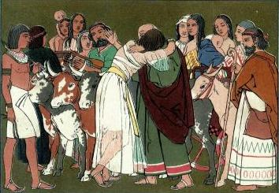
Genesis 46: 29-34
²⁹Joseph prepared his chariot, and went up to meet Israel, his father, in Goshen. He presented himself to him and fell on his neck, and wept on his neck a good while. ³⁰Israel said to Joseph, “Now let me die, since I have seen your face, that you are still alive.
³¹Joseph said to his brothers and to his father’s house, “I will go up and speak with Pharaoh and will tell him, ‘My brothers, and my father’s house, who were in the land of Canaan, have come to me. ³²These men are shepherds, for they have been keepers of livestock and they have brought their flocks, and their herds, and all that they have.’ ³³It will happen, when Pharaoh summons you, and will say, ‘What is your occupation?’ ³⁴that you shall say, ‘Your servants have been keepers of livestock from our youth even until now, both we, and our fathers:’ that you may dwell in the land of Goshen; for every shepherd is an abomination to the Egyptians.”

Slide 12
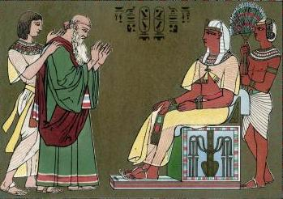
Genesis 47: 7-10
⁷Joseph brought in Jacob, his father, and set him before Pharaoh; and Jacob blessed Pharaoh. ⁸Pharaoh said to Jacob, “How old are you?”
⁹Jacob said to Pharaoh, “The years of my pilgrimage are one hundred thirty years. The days of the years of my life have been few and evil. They have not attained to the days of the years of the life of my fathers in the days of their pilgrimage.” ¹⁰Jacob blessed Pharaoh, and went out from the presence of Pharaoh.

Slide 13
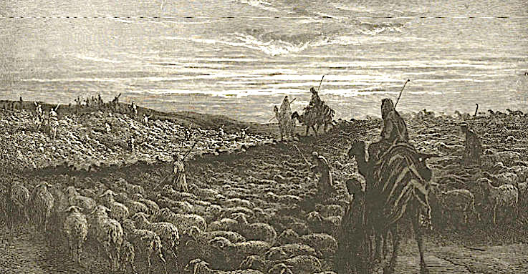
Genesis 47: 11-12, 29-31
¹¹Joseph placed his father and his brothers, and gave them a possession in the land of Egypt in the best of the land, in the land of Rameses, as Pharaoh had commanded. ¹²Joseph provided his father, his brothers, and all of his father’s household with bread according to the sizes of their families.
²⁹The time came near that Israel must die, and he called his son Joseph, and said to him, “If now I have found favor in your sight, please put your hand under my thigh, and deal kindly and truly with me. Please don’t bury me in Egypt, ³⁰but when I sleep with my fathers, you shall carry me out of Egypt, and bury me in their burying place.”
Joseph said, “I will do as you have said.”
³¹Israel said, “Swear to me,” and he swore to him. Then Israel bowed himself on the bed’s head.

Slide 14
Questions
Why was it necessary for God to instruct Jacob to go and settle down in Egypt? What may have been Jacob’s original plan?
Where in Egypt did Jacob’s family settle?
Why do you think shepherds were “an abomination” to Egyptians?
What was Jacob’s dying wish?

Slide 15
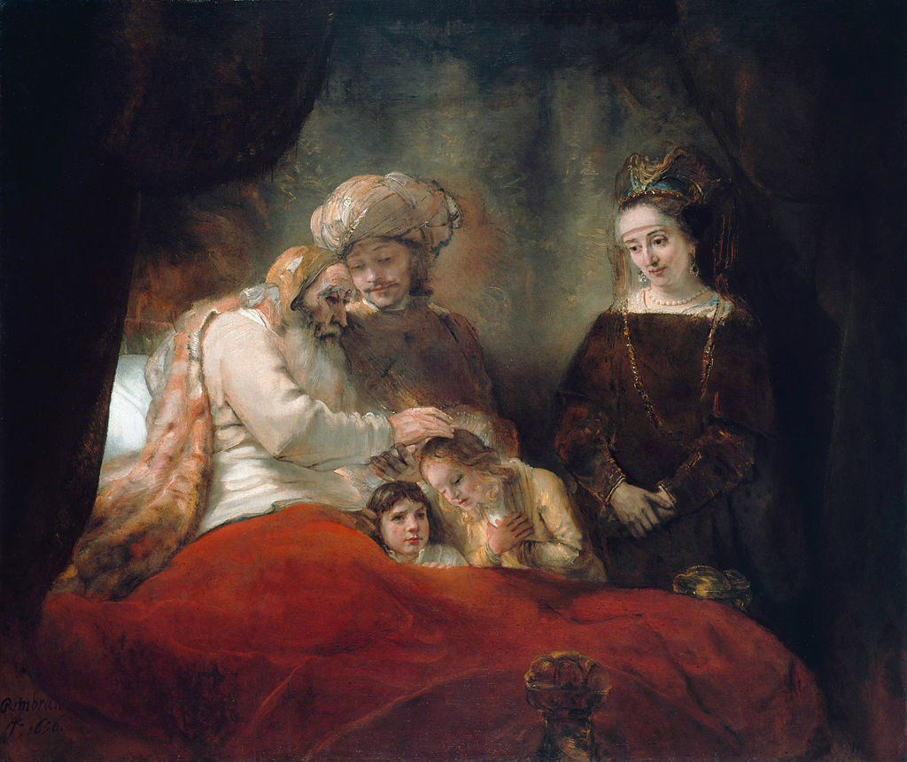
Genesis 48: 11-20
¹¹Israel said to Joseph, “I didn’t think I would see your face, and behold, God has let me see your offspring also.” ¹²Joseph brought them out from between his knees, and he bowed himself with his face to the earth. ¹³Joseph took them both, Ephraim in his right hand toward Israel’s left hand, and Manasseh in his left hand toward Israel’s right hand, and brought them near to him. ¹⁴Israel stretched out his right hand, and laid it on Ephraim’s head, who was the younger, and his left hand on Manasseh’s head, guiding his hands knowingly, for Manasseh was the firstborn.
¹⁵He blessed Joseph, and said, “The God before whom my fathers Abraham and Isaac walked, the God who has fed me all my life long to this day, ¹⁶the angel who has redeemed me from all evil, bless the lads, and let my name be named on them, and the name of my fathers Abraham and Isaac. Let them grow into a multitude upon the earth.”
¹⁷When Joseph saw that his father laid his right hand on the head of Ephraim, it displeased him. He held up his father’s hand, to remove it from Ephraim’s head to Manasseh’s head. ¹⁸Joseph said to his father, “Not so, my father, for this is the firstborn. Put your right hand on his head.”
¹⁹His father refused, and said, “I know, my son, I know. He also will become a people, and he also will be great. However, his younger brother will be greater than he, and his offspring will become a multitude of nations.” ²⁰He blessed them that day, saying, “Israel will bless in you, saying, ‘God make you as Ephraim and as Manasseh’” He set Ephraim before Manasseh.

Slide 16
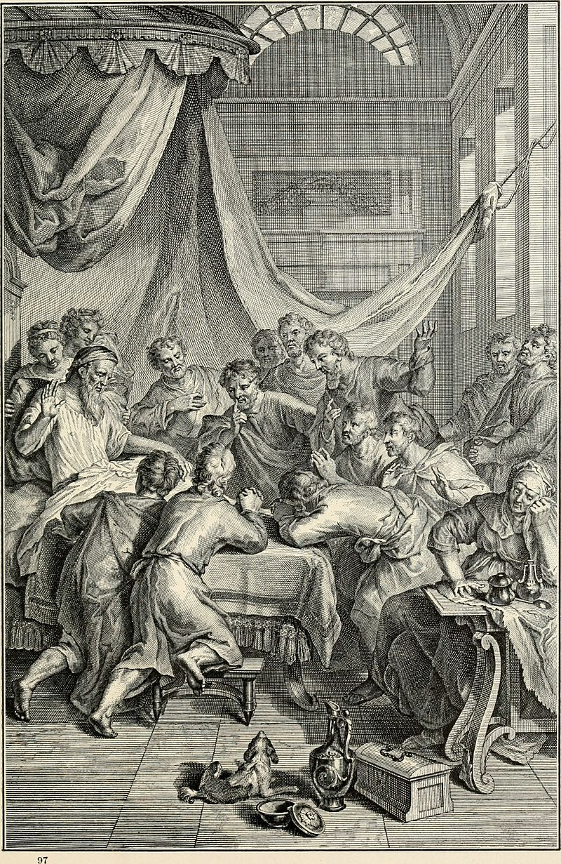
Genesis 49: 1-10
¹Jacob called to his sons, and said: “Gather yourselves together, that I may tell you that which will happen to you in the days to come. ²Assemble yourselves, and hear, you sons of Jacob. Listen to Israel, your father.
³“Reuben, you are my firstborn, my might, and the beginning of my strength, excelling in dignity, and excelling in power. ⁴Boiling over like water, you shall not excel, because you went up to your father’s bed, then defiled it.
⁵“Simeon and Levi are brothers. Their swords are weapons of violence. ⁶My soul, don’t come into their council. My glory, don’t be united to their assembly; for in their anger they killed men. In their self-will they hamstrung cattle. ⁷Cursed be their anger, for it was fierce; and their wrath, for it was cruel. I will divide them in Jacob, and scatter them in Israel.
⁸“Judah, your brothers will praise you. Your hand will be on the neck of your enemies. Your father’s sons will bow down before you. ⁹Judah is a lion’s cub. From the prey, my son, you have gone up. He stooped down, he crouched as a lion, as a lioness. Who will rouse him up? ¹⁰The scepter will not depart from Judah, nor the ruler’s staff from between his feet, until he comes to whom it belongs. The obedience of the peoples will be to him…”

Slide 17
Questions
Why do you think Jacob reversed the order of blessing Joseph’s sons?
Why did Jacob mean when he said that Reuben had “defiled” his father’s bed? (Gen 35:22)
Why was Jacob so critical of Simeon and Levi? (Gen 34:25)
Why did Jacob praise Judah?
What does it mean when Jacob said “the scepter will not depart from Judah”? What did he predict?

Slide 18
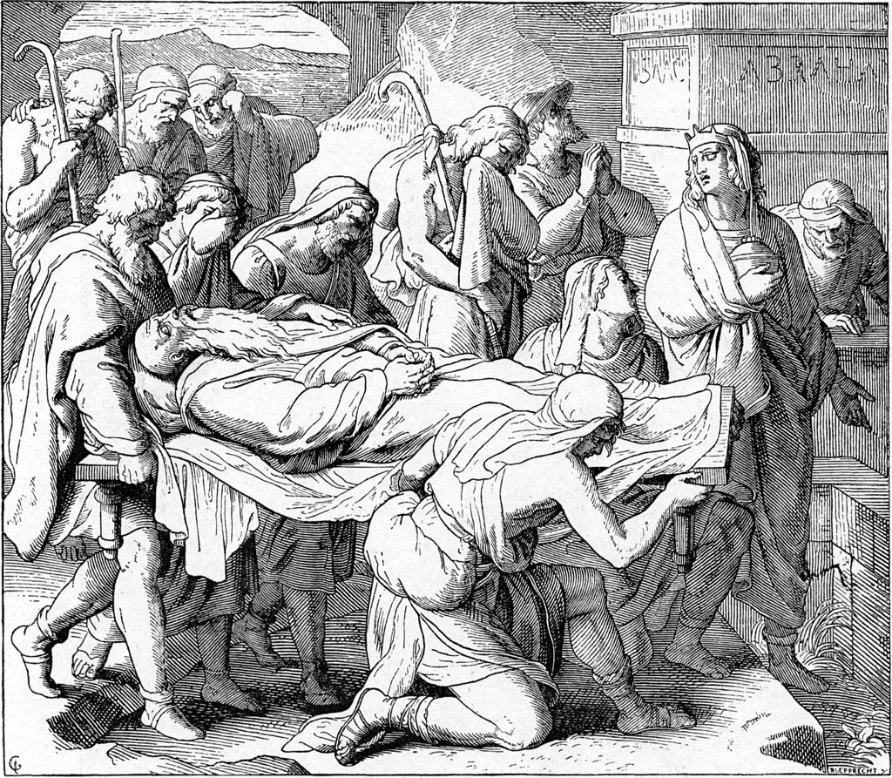
Genesis 50: 15-21
¹⁵When Joseph’s brothers saw that their father was dead, they said, “It may be that Joseph will hate us, and willfully pay us back for all the evil which we did to him.” ¹⁶They sent a message to Joseph saying, “Your father commanded before he died, saying, ¹⁷‘You shall tell Joseph, “Now please forgive the disobedience of your brothers, and their sin, because they did evil to you.”’ Now, please forgive the disobedience of the servants of the God of your father.” Joseph wept when they spoke to him. ¹⁸His brothers also went and fell down before his face; and they said, “Behold, we are your servants.” ¹⁹Joseph said to them, “Don’t be afraid, for am I in the place of God? ²⁰As for you, you meant evil against me, but God meant it for good to save many people alive, as is happening today. ²¹Now therefore don’t be afraid. I will provide for you and your little ones.” He comforted them and spoke kindly to them.

Slide 19
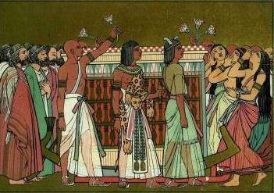
Genesis 50: 22-26
²²Joseph lived in Egypt, he, and his father’s house. Joseph lived one hundred ten years. ²³Joseph saw Ephraim’s children to the third generation. The children also of Machir, the son of Manasseh, were born on Joseph’s knees. ²⁴Joseph said to his brothers, “I am dying, but God will surely visit you, and bring you up out of this land to the land which he swore to Abraham, to Isaac, and to Jacob.”
²⁵Joseph took an oath from the children of Israel, saying, “God will surely visit you, and you shall carry up my bones from here.” ²⁶So Joseph died, being one hundred ten years old, and they embalmed him and he was put in a coffin in Egypt.

Slide 20
Questions
Why were Joseph’s brothers so worried after the death of their father?
Joseph said from his deathbed: God will surely visit you, and bring you up out of this land to the land which he swore to Abraham, to Isaac, and to Jacob (Gen 50:24). How long did they have to wait for God to ”visit” them?

Slide 21
Acknowledgments:
Scripture verses were taken from the World English Bible and edited for clarity.
Unless otherwise indicated, all images were downloaded from Wikimedia.
Most of the questions are derived from commentary from “The Rational Bible: Genesis” by Dennis Prager.

