Slide 1
Lesson plans for Genesis 42-44
Antonio Chaves

Slide 2
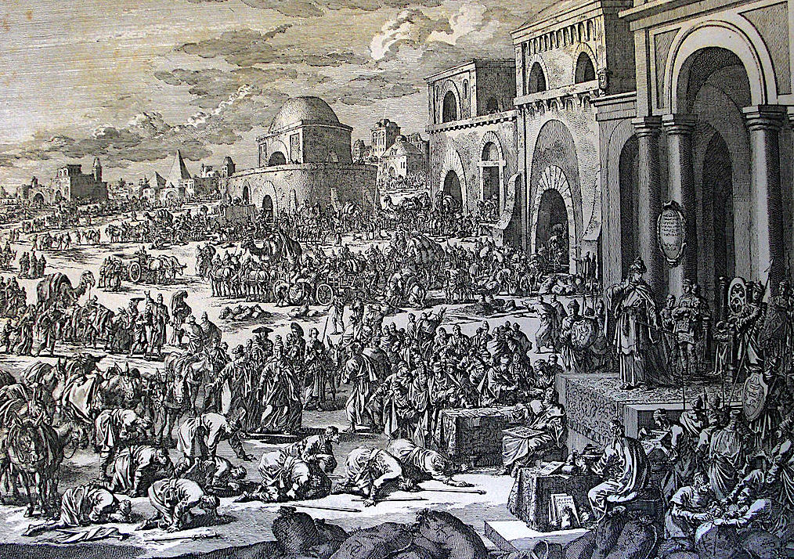
Genesis 42: 1-7
¹Now Jacob saw that there was grain in Egypt and Jacob said to his sons, “Why do you look at one another?” ²He said, “Behold, I have heard that there is grain in Egypt. Go down there and buy for us from there so that we may live.” ³Joseph’s ten brothers went down to buy grain from Egypt. ⁴But Jacob didn’t send Benjamin, Joseph’s brother, with his brothers; for he said, “Lest perhaps harm happen to him.” ⁵The sons of Israel came to buy among those who came, for the famine was in the land of Canaan.
⁶Joseph was the governor over the land. It was he who sold to all the people of the land. Joseph’s brothers came, and bowed themselves down to him with their faces to the earth. ⁷Joseph saw his brothers, and he recognized them, but acted like a stranger to them and spoke roughly with them. He said to them, “Where did you come from?”

Slide 3
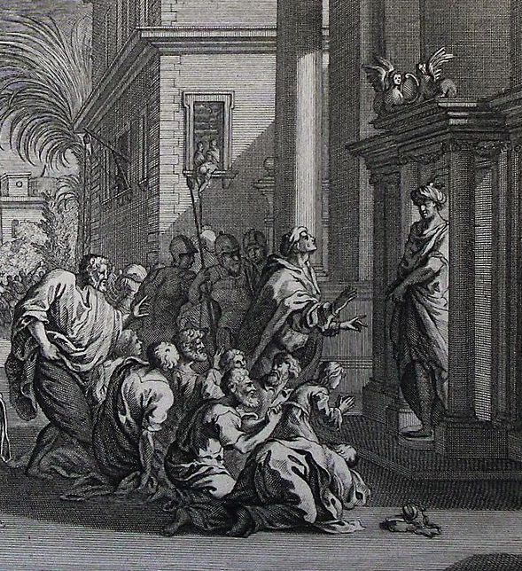
Genesis 42: 9-17
⁹Joseph remembered the dreams which he dreamed about them and said to them, “You are spies! You have come to see the nakedness of the land.”
¹⁰They said to him, “No, my lord, but your servants have come to buy food. ¹¹We are all one man’s sons; we are honest men. Your servants are not spies.”
¹²He said to them, “No, but you have come to see the nakedness of the land!”
¹³They said, “We, your servants, are twelve brothers, the sons of one man in the land of Canaan; and behold, the youngest is today with our father and one is no more.”
¹⁴Joseph said to them, “It is like I told you, saying, ‘You are spies!’ ¹⁵By this you shall be tested. By the life of Pharaoh, you shall not go out from here unless your youngest brother comes here. ¹⁶Send one of you and let him get your brother, and you shall be bound that your words may be tested whether there is truth in you, or else by the life of Pharaoh surely you are spies.” ¹⁷He put them all together into custody for three days.

Slide 4
Questions
Why did Joseph pretend not to know his brothers and proceed to treat them so harshly?
Why did Joseph demand they bring back Benjamin?

Slide 5
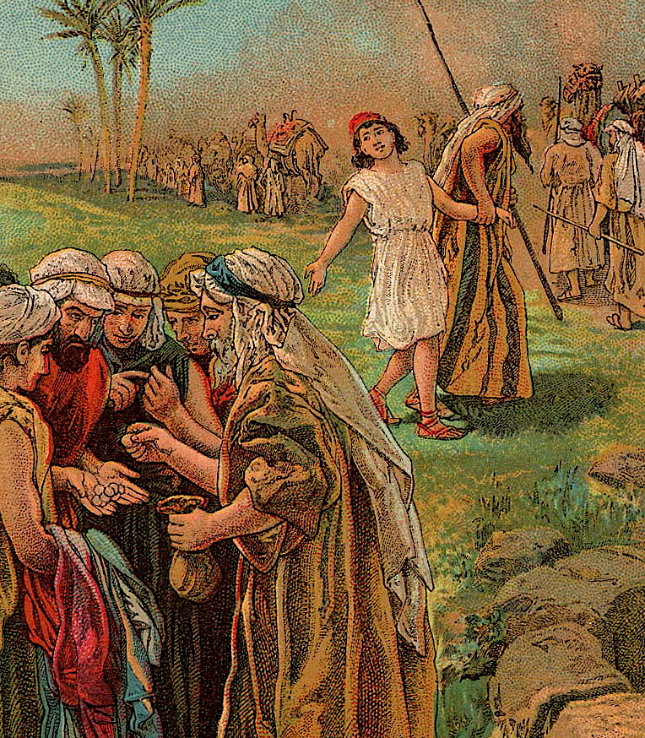
Genesis 42: 18-22
¹⁸Joseph said to them the third day, “Do this and live, for I fear God. ¹⁹If you are honest men then let one of your brothers be bound in your prison; but you go, carry grain for the famine of your houses. ²⁰Bring your youngest brother to me; so will your words be verified and you won’t die.”
They did so. ²¹They said to one another, “We are certainly guilty concerning our brother in that we saw the distress of his soul when he begged us and we wouldn’t listen. Therefore this distress has come upon us.” ²²Reuben answered them saying, “Didn’t I tell you, saying, ‘Don’t sin against the child,’ and you wouldn’t listen?”

Slide 6
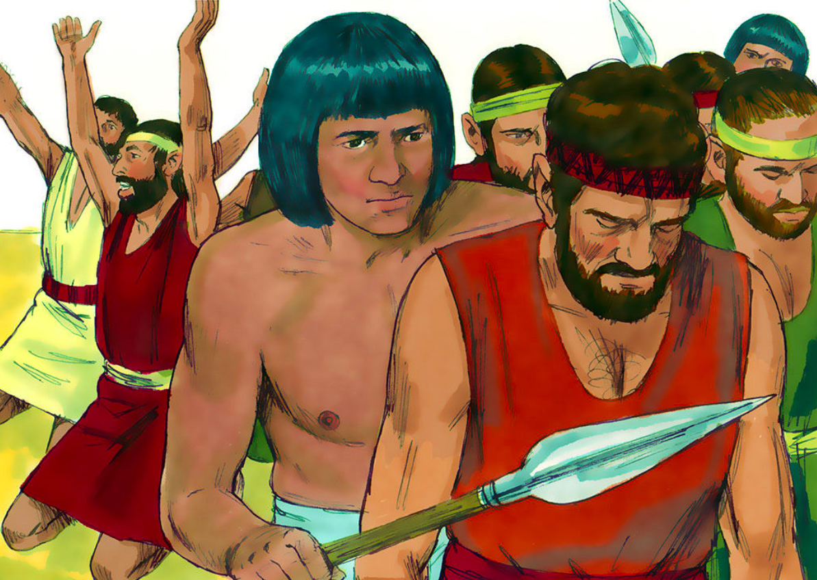
Genesis 42: 23-28
²³They didn’t know that Joseph understood them; for there was an interpreter between them. ²⁴He turned himself away from them and wept. Then he returned to them, and spoke to them, and took Simeon from among them, and bound him before their eyes. ²⁵Then Joseph gave a command to fill their bags with grain, and to restore each man’s money into his sack, and to give them food for the way. So it was done to them.
²⁶They loaded their donkeys with their grain, and departed from there.
Downloaded from FreeBibleimages.org
²⁷As one of them opened his sack to give his donkey food in the lodging place he saw his money. Behold, it was in the mouth of his sack. ²⁸He said to his brothers, “My money is restored! Behold, it is in my sack!” Their hearts failed them, and they turned trembling to one another saying, “What is this that God has done to us?”

Slide 7
Questions
Shortly after their arrival Joseph arrested all of his brothers. Why did Joseph soften his stance on the third day and only keep one of them?
Which brother did Joseph detain?
Why did all the brothers think they were “being punished”?

Slide 8
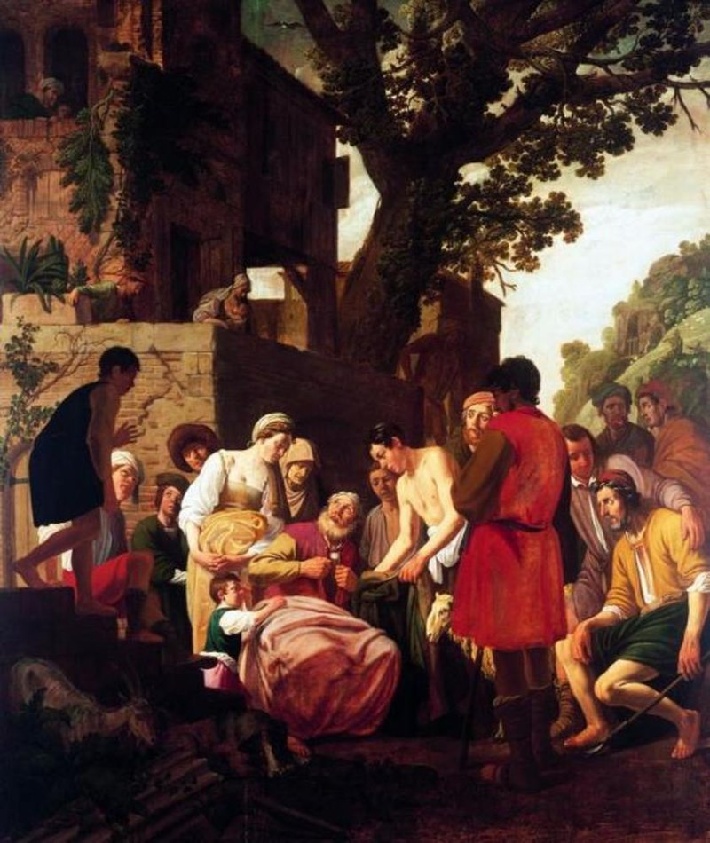
Genesis 42: 29-34
²⁹They came to Jacob their father, to the land of Canaan and told him all that had happened, saying, ³⁰ “The man, the lord of the land, spoke roughly with us, and took us for spies of the country. ³¹We said to him, ‘We are honest men. We are no spies. ³²We are twelve brothers, sons of our father; one is no more, and the youngest is today with our father in the land of Canaan.’ ³³The man, the lord of the land, said to us, ‘By this I will know that you are honest men: leave one of your brothers with me, and take grain for the famine of your houses, and go your way. ³⁴Bring your youngest brother to me. Then I will know that you are not spies, but that you are honest men. So I will deliver your brother to you and you shall trade in the land.’”

Slide 9
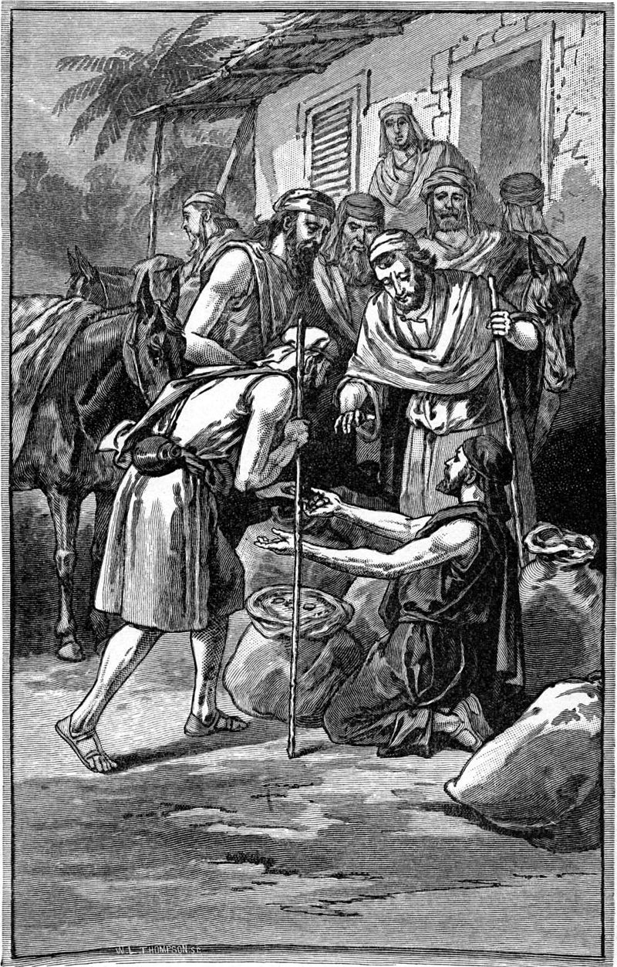
Genesis 42: 35-38
³⁵As they emptied their sacks, behold, each man’s bundle of money was in his sack. When they and their father saw their bundles of money, they were afraid. ³⁶Jacob, their father, said to them, “You have bereaved me of my children! Joseph is no more, Simeon is no more, and you want to take Benjamin away. All these things are against me.”
³⁷Reuben spoke to his father, saying, “Kill my two sons, if I don’t bring him to you. Entrust him to my care and I will bring him to you again.”
³⁸He said, “My son shall not go down with you; for his brother is dead, and he only is left. If harm happens to him along the way in which you go, then you will bring down my gray hairs with sorrow to Sheol.”

Slide 10
Questions
Why were the brothers ”frightened” when they saw the silver in their sacks?
What did Reuben say to his father to reassure him that Benjamin would be safe?

Slide 11
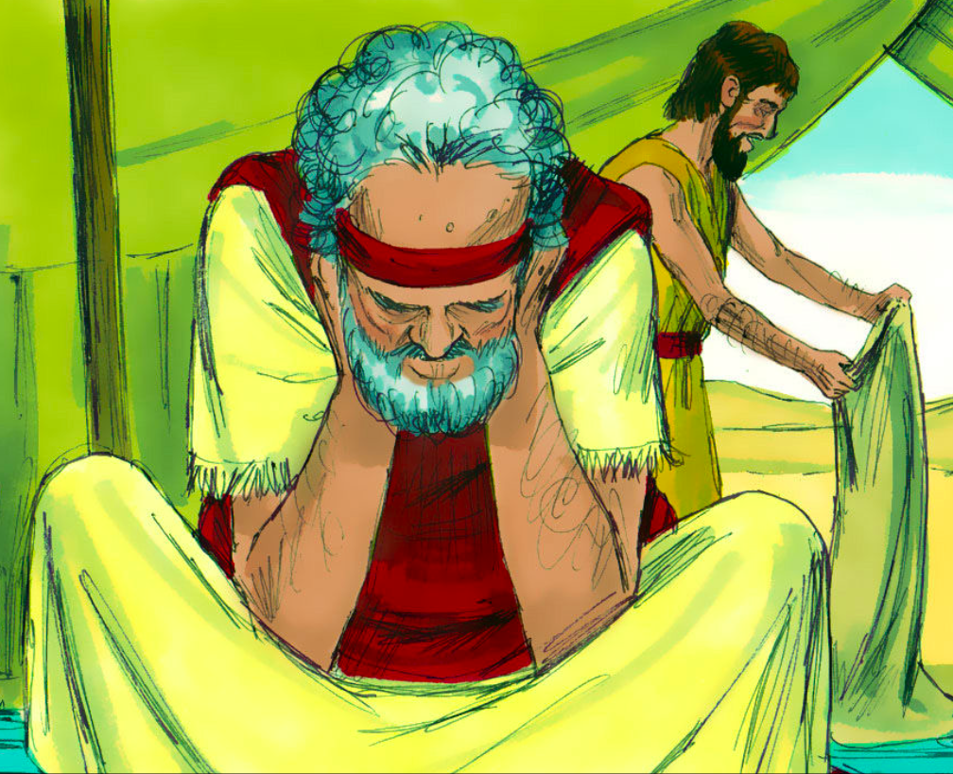
Genesis 43: 1-7
¹The famine was severe in the land. ²When they had eaten up the grain which they had brought out of Egypt, their father said to them, “Go again, buy us a little more food.”
³Judah spoke to him, saying, “The man solemnly warned us saying, ‘You shall not see my face unless your brother is with you.’ ⁴If you’ll send our brother with us, we’ll go down and buy you food; ⁵but if you don’t send him we won’t go down, for the man said to us, ‘You shall not see my face, unless your brother is with you.’”
Downloaded from FreeBibleimages.org
⁶Israel said, “Why did you tell the man that you had another brother?”
⁷They said, “The man asked directly concerning ourselves and concerning our relatives, saying, ‘Is your father still alive? Have you another brother?’ We just answered his questions. Is there any way we could know that he would say, ‘Bring your brother down?’”

Slide 12
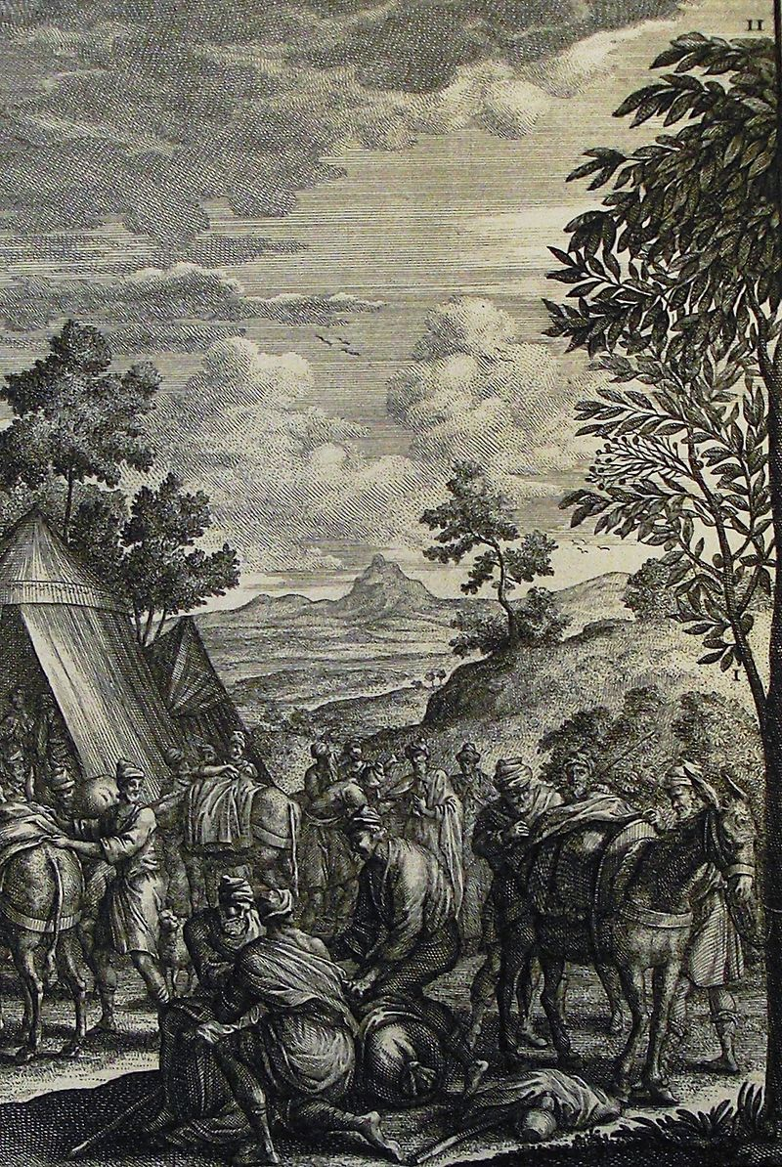
Genesis 43: 8-14
⁸Judah said to his father, “Send the boy with me and we’ll get up and go and not all die. ⁹I’ll be collateral for him. From my hand will you require him. If I don’t bring him to you, and set him before you, then let me bear the blame forever; ¹⁰for if we hadn’t delayed surely we would have returned a second time by now.”
¹¹Their father said to them, “If it must be so, then do this: Take from the choice fruits of the land in your bags, and carry down a present for the man, a little balm, a little honey, spices and myrrh, nuts, and almonds; ¹²and take double money in your hand, and take back the money that was returned in the mouth of your sacks. Perhaps it was an oversight. ¹³Take your brother also, get up, and return to the man. ¹⁴May God Almighty give you mercy before the man, that he may release to you your other brother and Benjamin. If I am bereaved of my children, I am bereaved.”

Slide 13
Questions
Why was Jacob so worried about losing Benjamin?
How did Judah reassure his father as to the safety of Benjamin?
Why did Jacob finally agree to allowing Benjamin to join his brothers on their second trip to Egypt?
What did Jacob order his sons to do to further insure the safety of Benjamin?

Slide 14
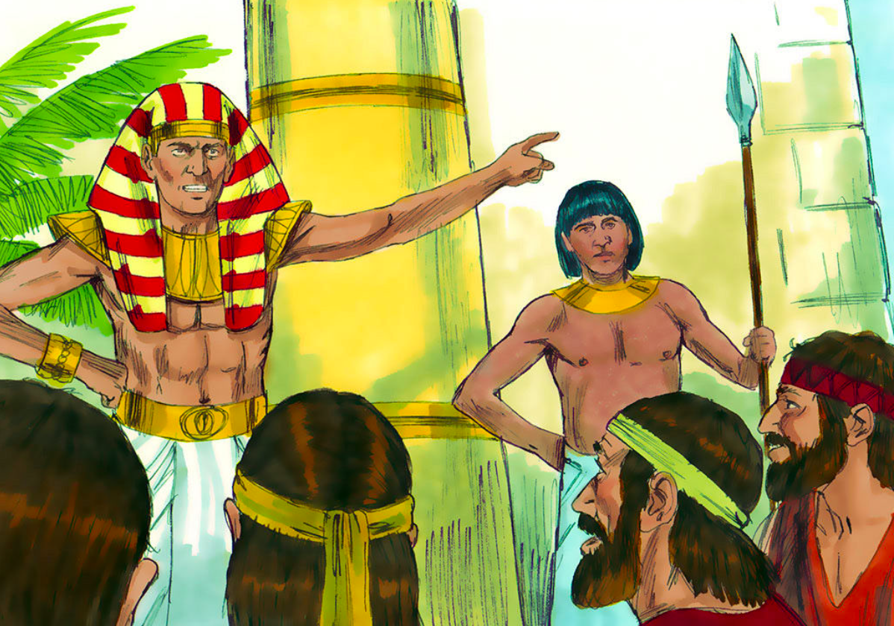
Genesis 43: 15-18
¹⁵The men took that present, and they took double money in their hand and Benjamin; and went down to Egypt, and stood before Joseph. ¹⁶When Joseph saw Benjamin with them, he said to the steward of his house, “Bring the men into the house, and butcher an animal, and prepare; for the men will dine with me at noon.”
¹⁷The man did as Joseph commanded and the man brought the men to Joseph’s house.
Downloaded from FreeBibleimages.org
¹⁸The men were afraid because they were brought to Joseph’s house; and they said, “Because of the money that was returned in our sacks the first time we’re brought in; that he may seek occasion against us, attack us, and seize us as slaves, along with our donkeys.”

Slide 15
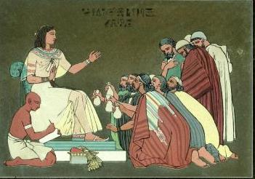
Genesis 43: 19-28
¹⁹They came near to the steward of Joseph’s house, and they spoke to him at the door of the house ²⁰and said, “Oh, my lord, we indeed came down the first time to buy food. ²¹When we came to the lodging place, we opened our sacks, and behold, each man’s money was in the mouth of his sack, our money in full weight. We have brought it back in our hand. ²²We have brought down other money in our hand to buy food. We don’t know who put our money in our sacks.”
²³He said, “Peace be to you. Don’t be afraid. Your God, and the God of your father, has given you treasure in your sacks. I received your money.” He brought Simeon out to them. ²⁴The man brought the men into Joseph’s house, and gave them water, and they washed their feet. He gave their donkeys fodder. ²⁵They prepared the present for Joseph’s coming at noon, for they heard that they should eat bread there.
²⁶When Joseph came home, they brought him the present which was in their hand into the house, and bowed themselves down to the earth before him. ²⁷He asked them of their welfare, and said, “Is your father well, the old man of whom you spoke? Is he yet alive?”
²⁸They said, “Your servant, our father, is well. He is still alive.” They bowed down humbly.

Slide 16
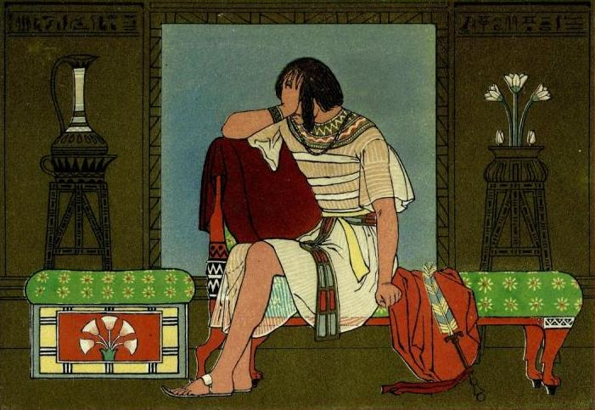
Genesis 43: 29-31
²⁹He lifted up his eyes and saw Benjamin, his mother’s son, and said, “Is this your youngest brother, of whom you spoke to me?” He said, “God be gracious to you, my son.” ³⁰Joseph hurried, for his heart yearned over his brother; and he sought a place to weep. He entered into his room and wept there. ³¹He washed his face and came out. He controlled himself and said, “Serve the meal.”

Slide 17
Questions
Why were the brothers frightened when Joseph took them into his house?
How did the steward respond after they expressed their concerns?
What did Joseph see that moved him to the point of weeping?

Slide 18
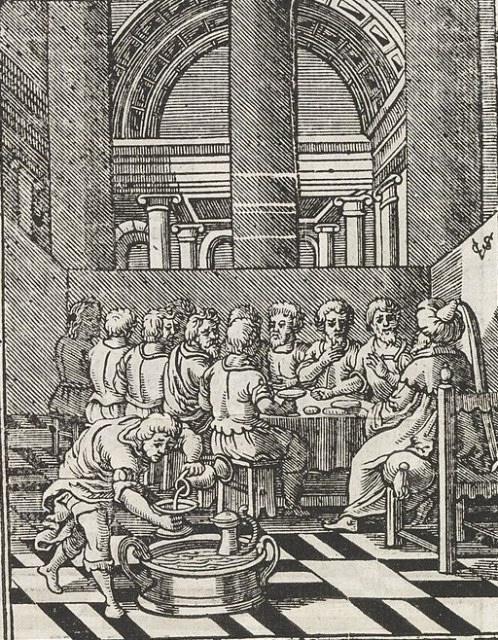
Genesis 43: 32-34
³²They served him by himself and them by themselves, and the Egyptians who ate with him by themselves, because the Egyptians don’t eat with the Hebrews, for that is an abomination to the Egyptians. ³³They sat before him, the firstborn according to his birthright, and the youngest according to his youth, and the men marveled with one another. ³⁴He sent portions to them from before him, but Benjamin’s portion was five times as much as any of theirs. They drank, and were merry with him.

Slide 19
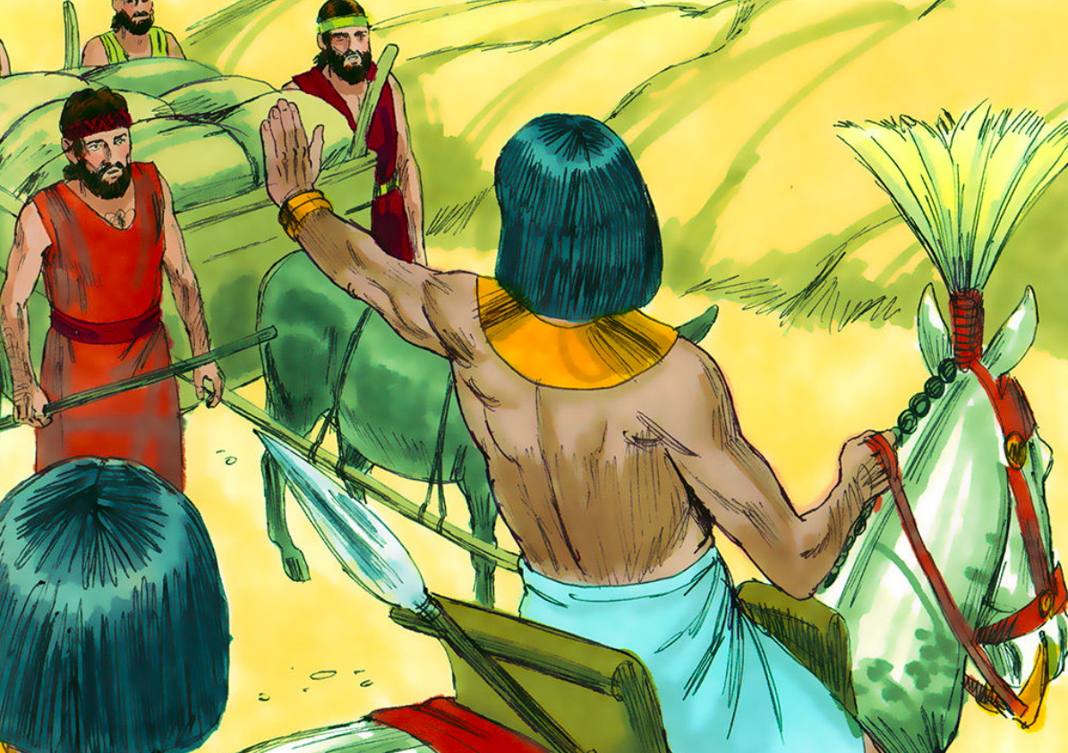
Genesis 44: 1-5
¹He commanded the steward of his house saying, “Fill the men’s sacks with food, as much as they can carry, and put each man’s money in his sack’s mouth. ²Put my cup, the silver cup, in the sack’s mouth of the youngest, with his grain money.” He did according to the word that Joseph had spoken.
Downloaded from FreeBibleimages.org
³As soon as the morning was light, the men were sent away they and their donkeys. ⁴When they had gone out of the city and were not yet far off, Joseph said to his steward, “Up, follow after the men. When you overtake them, ask them, ‘Why have you rewarded evil for good? ⁵Isn’t this that from which my lord drinks and by which he indeed divines? You have done evil in so doing.’”

Slide 20
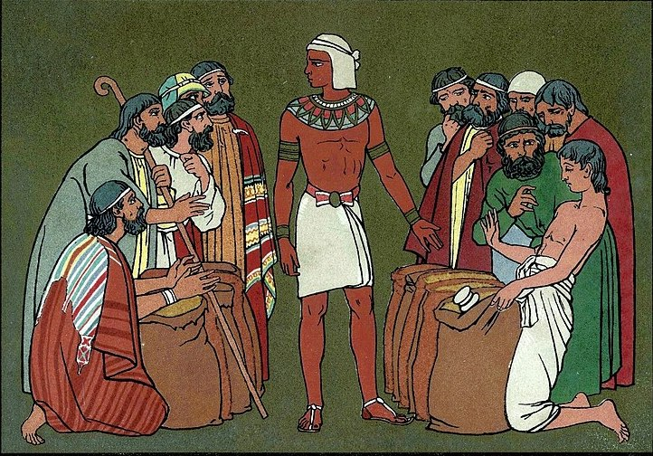
Genesis 44: 6-13
⁷They said to him, “Why does my lord speak such words as these? Far be it from your servants that they should do such a thing! ⁸Behold, the money, which we found in our sacks’ mouths, we brought again to you out of the land of Canaan. How then should we steal silver or gold out of your lord’s house? ⁹With whomever of your servants it is found, let him die, and we also will be my lord’s slaves.”
¹⁰He said, “Now also let it be according to your words. He with whom it is found will be my slave; and you will be blameless.”
¹¹Then they hurried and each man took his sack down to the ground, and each man opened his sack. ¹²He searched, beginning with the oldest, and ending at the youngest. The cup was found in Benjamin’s sack. ¹³Then they tore their clothes, and each man loaded his donkey, and returned to the city.

Slide 21
Questions
Which brother got preferential treatment at the feast?
What did the steward propose to do with whoever “stole” the silver cup?
Which brother’s sack contained the silver cup?
Why did Joseph choose to frame his youngest brother for theft of the silver cup?

Slide 22
Acknowledgments:
Scripture verses were taken from the World English Bible and edited for clarity.
Unless otherwise indicated, all images were downloaded from Wikimedia.
Most of the questions are derived from commentary from “The Rational Bible: Genesis” by Dennis Prager.

