Slide 1
Lesson plans for Genesis 28-31
Antonio Chaves

Slide 2
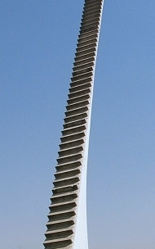
Genesis 28: 10-15
¹⁰Jacob went out from Beersheba and went toward Haran. ¹¹He came to a certain place and stayed there all night because the sun had set. He took one of the stones of the place and put it under his head, and lay down in that place to sleep. ¹²He dreamed and saw a stairway set upon the earth and its top reached to heaven. Behold, the angels of God were ascending and descending on it. ¹³Behold, Yahweh stood above it and said, “I am Yahweh, the God of Abraham your father and the God of Isaac. I will give the land you lie on to you and to your offspring. ¹⁴Your offspring will be as the dust of the earth, and you will spread abroad to the west, and to the east, and to the north, and to the south. In you and in your offspring, all the families of the earth will be blessed. ¹⁵Behold, I am with you, and will keep you, wherever you go, and will bring you again into this land. For I will not leave you until I have done that which I have spoken of to you.”

Slide 3
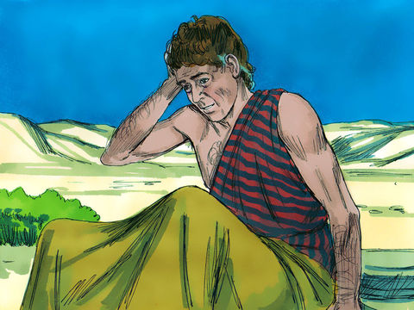
Genesis 28: 16-22
¹⁶Jacob awakened out of his sleep and he said, “Surely Yahweh is in this place and I didn’t know it.” ¹⁷He was afraid and said, “How awesome this place is! This is none other than God’s house and this is the gate of heaven.”
¹⁸Jacob rose up early in the morning and took the stone that he had put under his head and set it up for a pillar and poured oil on its top. ¹⁹He called the name of that place Bethel, but the name of the city was Luz at the first. ²⁰Jacob vowed a vow, saying, “If God will be with me and will keep me in this way that I go, and will give me bread to eat and clothing to put on ²¹so that I come again to my father’s house in peace and Yahweh will be my God, ²²then this stone, which I have set up for a pillar will be God’s house. Of all that you will give me I will surely give a tenth to you.”
Downloaded from FreeBibleimages.org

Slide 4
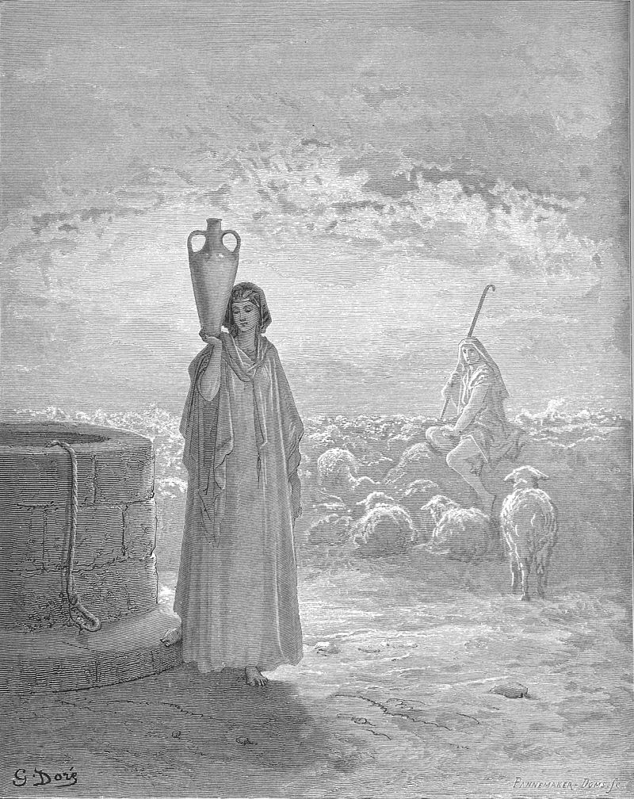
Genesis 29: 1-6
¹Then Jacob went on his journey and came to the land of the children of the east. ²He looked and saw a well and three flocks of sheep lying there by it. For out of that well they watered the flocks. The stone on the well’s mouth was large. ³There all the flocks were gathered. They rolled the stone from the well’s mouth and watered the sheep, and put the stone back on the well’s mouth in its place. ⁴Jacob said to them, “My relatives, where are you from?”
They said, “We are from Haran.”
⁵He said to them, “Do you know Laban, the son of Nahor?”
They said, “We know him.”
⁶He said to them, “Is it well with him?”
They said, “It is well. See, Rachel, his daughter, is coming with the sheep.”

Slide 5
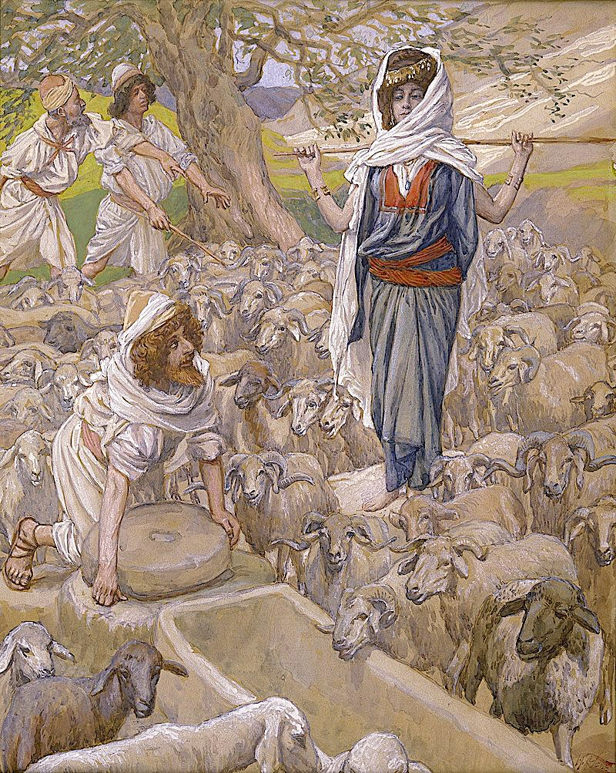
Genesis 29: 7-10
⁷He said, “Behold, it is still the middle of the day, not time to gather the livestock together. Water the sheep and go and feed them.”
⁸They said, “We can’t, until all the flocks are gathered together, and they roll the stone from the well’s mouth. Then we will water the sheep.”
⁹While he was yet speaking with them, Rachel came with her father’s sheep. ¹⁰When Jacob saw Rachel the daughter of Laban, his mother’s brother, and the sheep of Laban, Jacob went near and rolled the stone from the well’s mouth, and watered the flock of Laban his mother’s brother.

Slide 6
Questions
Is it theologically sound for Jacob to make his faith in God conditional upon God’s protection?
Why did Jacob roll the stone away from the top of the well when Rachel arrived?

Slide 7
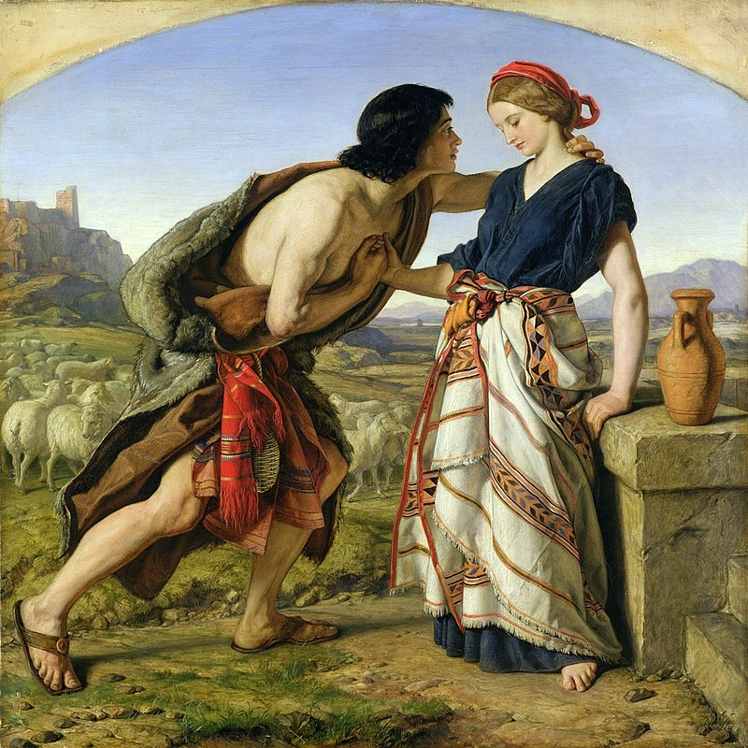
Genesis 29: 11-15
¹¹Jacob kissed Rachel, and lifted up his voice, and wept. ¹²Jacob told Rachel that he was her father’s relative and that he was Rebekah’s son. She ran and told her father.
¹³When Laban heard the news of Jacob, he ran to meet Jacob and embraced him and brought him to his house. Jacob told Laban all these things. ¹⁴Laban said to him, “Surely you are my bone and my flesh.” Jacob stayed with him for a month. ¹⁵Laban said to Jacob, “Because you are my relative should you therefore serve me for nothing? Tell me what will your wages be?”

Slide 8
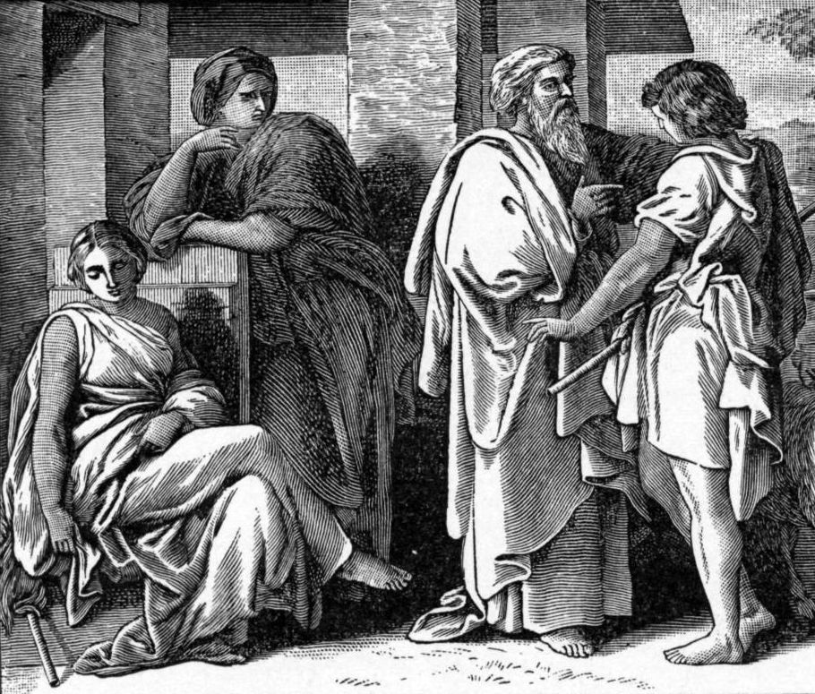
Genesis 29: 16-21
¹⁶Laban had two daughters. The name of the elder was Leah and the name of the younger was Rachel. ¹⁷Leah’s eyes were weak, but Rachel was beautiful in form and attractive. ¹⁸Jacob loved Rachel. He said, “I will serve you seven years for Rachel, your younger daughter.”
¹⁹Laban said, “It is better that I give her to you, than that I should give her to another man. Stay with me.”
²⁰Jacob served seven years for Rachel. They seemed to him but a few days for the love he had for her.
²¹Jacob said to Laban, “Give me my wife, for my days are fulfilled, that I may go to her.”

Slide 9
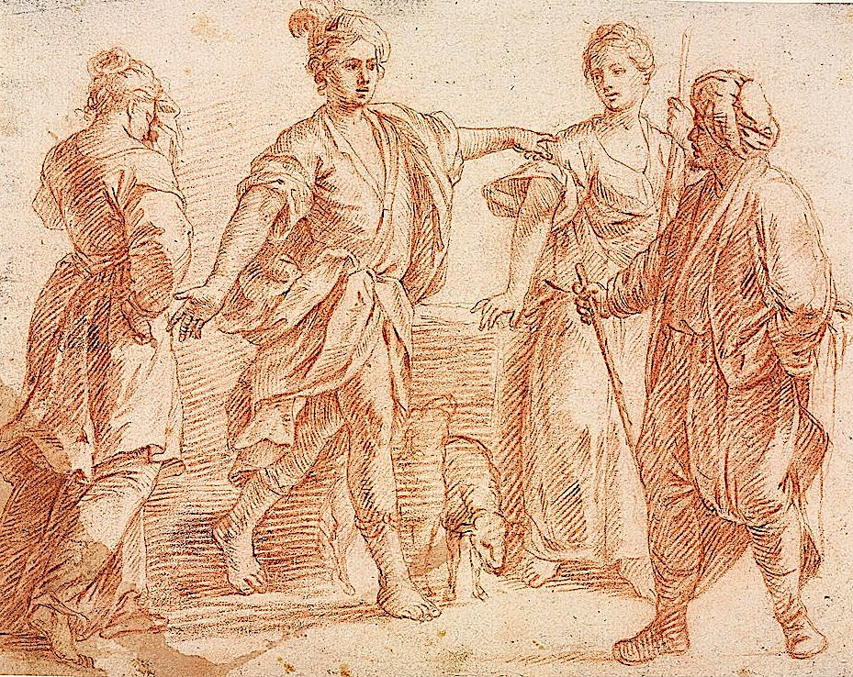
Genesis 29: 22-30
²²Laban gathered together all the men of the place and made a feast. ²³In the evening he took Leah his daughter, and brought her to Jacob. He went in to her. ²⁴Laban gave Zilpah his servant to his daughter Leah for a servant. ²⁵In the morning, behold, it was Leah! He said to Laban, “What is this you have done to me? Didn’t I serve with you for Rachel? Why then have you deceived me?”
²⁶Laban said, “It is not done so in our place to give the younger before the firstborn. ²⁷Fulfill the week of this one, and we will give you the other also for the service which you will serve with me for seven more years.”
²⁸Jacob did so, and fulfilled her week. He gave him Rachel his daughter as wife. ²⁹Laban gave Bilhah, his servant, to his daughter Rachel to be her servant. ³⁰He went in also to Rachel and he loved also Rachel more than Leah, and served with him seven more years.

Slide 10
Questions
What is the one word that best describes Laban?
Some have argued that Laban’s deception of Jacob was a form of poetic justice. How is this so?
Does the Old Testament promote polygamy?

Slide 11
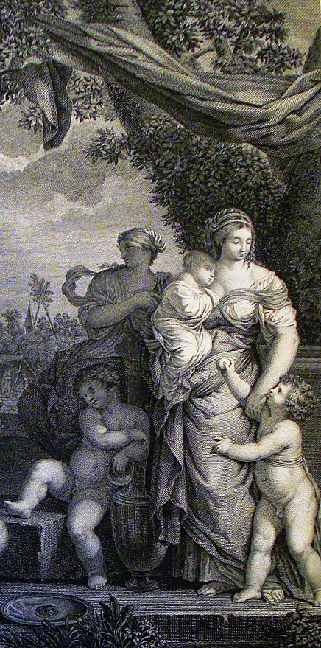
Genesis 29: 31-35
³¹Yahweh saw that Leah was not loved and he opened her womb, but Rachel was barren. ³²Leah conceived and bore a son, and she named him Reuben. For she said, “Because Yahweh has looked at my affliction; for now my husband will love me.” ³³She conceived again, and bore a son and said, “Because Yahweh has heard that I am not loved, he has therefore given me this son also.” She named him Simeon. ³⁴She conceived again, and bore a son. She said, “Now this time my husband will be joined to me because I have borne him three sons.” Therefore his name was called Levi. ³⁵She conceived again, and bore a son. She said, “This time I will praise Yahweh.” Therefore she named him Judah. Then she stopped bearing.

Slide 12
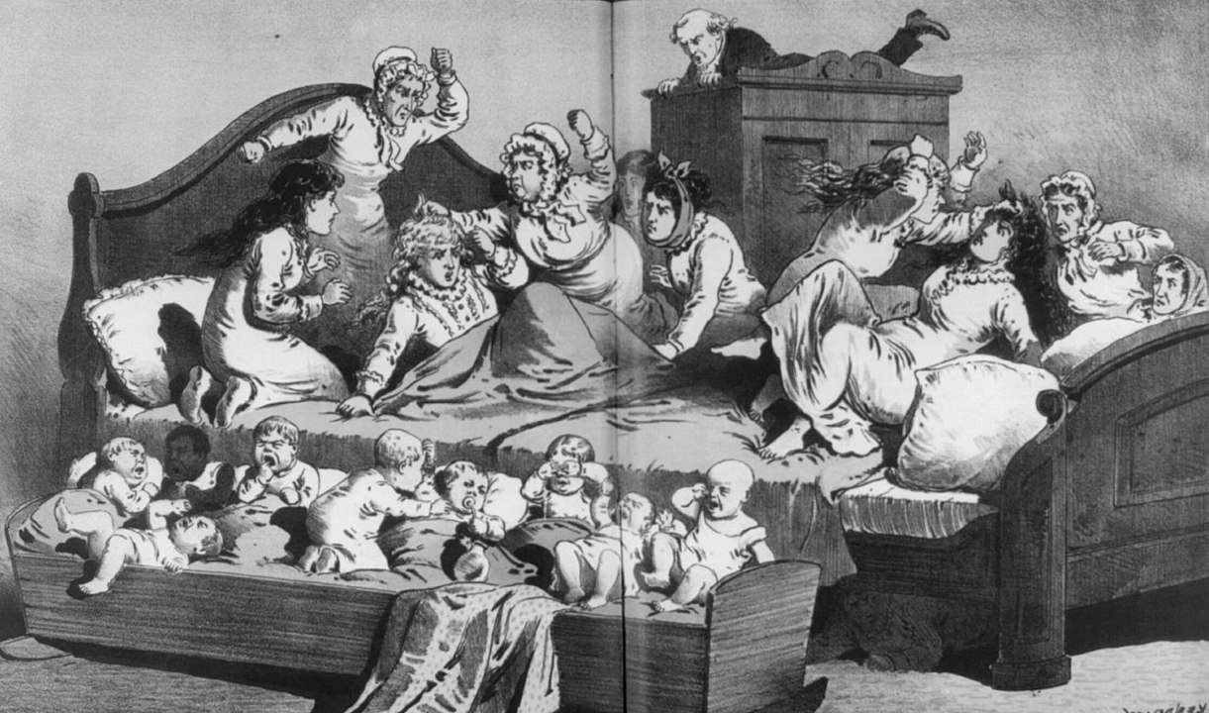
Genesis 30: 1-13
¹When Rachel saw that she bore Jacob no children, Rachel envied her sister. She said to Jacob, “Give me children, or else I will die.”
²Jacob’s anger burned against Rachel, and he said, “Am I in God’s place, who has withheld from you the fruit of the womb?”
³She said, “Behold, my maid Bilhah. Go in to her, that she may bear and I also may obtain children by her. ⁴She gave him Bilhah her servant as wife and Jacob went to her. ⁵Bilhah conceived, and bore Jacob a son. ⁶Rachel said, “God has judged me, and has also heard my voice, and has given me a son.” Therefore she called his name Dan. ⁷Bilhah, Rachel’s servant, conceived again and bore Jacob a second son. ⁸Rachel said, “I have wrestled with my sister with mighty wrestlings, and have prevailed.” She named him Naphtali.
⁹When Leah saw that she had finished bearing, she took Zilpah, her servant, and gave her to Jacob as a wife. ¹⁰Zilpah, Leah’s servant, bore Jacob a son. ¹¹Leah said, “How fortunate!” She named him Gad. ¹²Zilpah, bore Jacob a second son. ¹³ …She named him Asher.

Slide 13
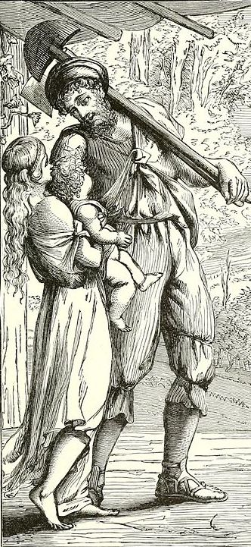
Genesis 30: 17-24
¹⁷God listened to Leah, and she conceived, and bore Jacob a fifth son. ¹⁸Leah said, “God has given me my hire, because I gave my servant to my husband.” She named him Issachar. ¹⁹Leah conceived again, and bore a sixth son to Jacob. ²⁰Leah said, “God has endowed me with a good dowry. Now my husband will live with me, because I have borne him six sons.” She named him Zebulun. ²¹Afterwards she bore a daughter and named her Dinah.
²²God remembered Rachel and God listened to her and opened her womb. ²³She conceived, bore a son and said, “God has taken away my reproach.” ²⁴She named him Joseph saying, “May Yahweh add another son to me.”

Slide 14
Questions
How did God compensate Leah for not being loved?
Is the Old Testament sexist?
Name a woman from Genesis who demonstrated initiative in carrying out God’s plan. Can you name another woman from later in the Old Testament who demonstrated the same qualities?

Slide 15
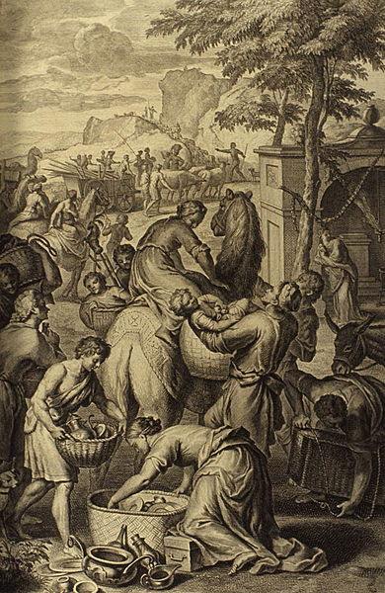
Genesis 30: 40-43, 31: 1-3, 21
30) ⁴⁰Jacob …kept his own sheep apart and didn’t put them into Laban’s flock. ⁴¹Whenever the stronger of the flock conceived, Jacob laid the rods in front of the eyes of the flock in the watering troughs that they might conceive among the rods; ⁴²but when the flock were feeble he didn’t put them in. So the feebler were Laban’s and the stronger Jacob’s. ⁴³The man increased exceedingly and had large flocks, female servants and male servants, and camels and donkeys.
31) ¹Jacob heard Laban’s sons’ words, saying, “Jacob has taken away all that was our father’s. He has obtained all this wealth from that which was our father’s.” ²Jacob saw the expression on Laban’s face, and behold, it was not toward him as before. ³Yahweh said to Jacob, “Return to the land of your fathers and to your relatives, and I will be with you.”… ²¹So he fled with all that he had. He rose up, passed over the River, and set his face toward the mountain of Gilead.

Slide 16
Questions
Laban’s sons accused Jacob of “taking away all that was their father’s.” What does this reveal about their character?
Why did God tell Jacob to flee from Laban?

Slide 17
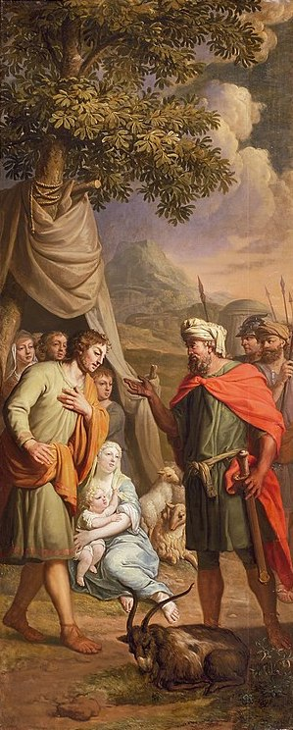
Genesis 31: 22-27
²²Laban was told on the third day that Jacob had fled. ²³He took his relatives with him, and pursued him seven days’ journey. He overtook him in the mountain of Gilead. ²⁴God came to Laban the Syrian in a dream of the night and said to him, “Be careful that you don’t speak to Jacob either good or bad.”
²⁵Laban caught up with Jacob. Now Jacob had pitched his tent in the mountain, and Laban with his relatives encamped in the mountain of Gilead. ²⁶Laban said to Jacob, “What have you done, that you have deceived me and carried away my daughters like captives of the sword? ²⁷Why did you flee secretly and deceive me, and didn’t tell me that I might have sent you away with mirth and with songs, with tambourine and with harp…

Slide 18
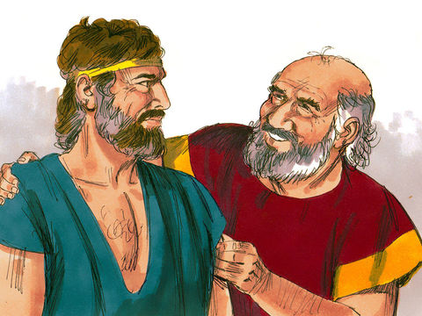
Genesis 31: 36, 38-39, 44, 55
³⁶Jacob was angry, and argued with Laban. Jacob answered Laban, “What is my trespass? What is my sin, that you have hotly pursued me? … ³⁸“These twenty years I have been with you. Your ewes and your female goats have not cast their young, and I haven’t eaten the rams of your flocks. ³⁹That which was torn of animals, I didn’t bring to you. I bore its loss. Of my hand you required it, whether stolen by day or stolen by night… ⁴⁴Now come, let’s make a covenant, you and I. Let it be for a witness between me and you.”… ⁵⁵Early in the morning, Laban rose up, and kissed his sons and his daughters, and blessed them. Laban departed and returned to his place.
Downloaded from FreeBibleimages.org

Slide 19
Questions
Do you really think Laban would have sent off Jacob with “mirth and songs”?
How is this grandiose claim consistent with Laban’s character?
Why did Laban make peace with Jacob?

Slide 20
Acknowledgments:
Scripture verses were taken from the World English Bible and edited for clarity.
Unless otherwise indicated, all images were downloaded from Wikimedia.
Most of the questions are derived from commentary from “The Rational Bible: Genesis” by Dennis Prager.

