Slide 1
Lesson plans for Genesis 18-22
Antonio Chaves

Slide 2
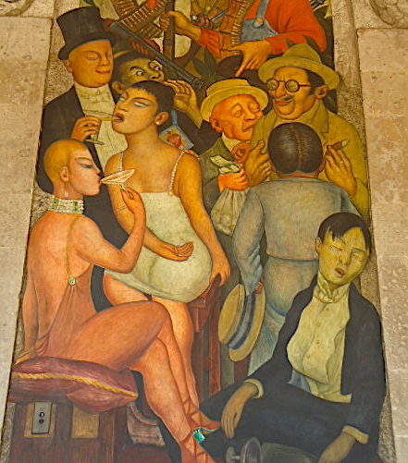
Genesis 18: 17-22
¹⁷Yahweh said, “Will I hide from Abraham what I do, ¹⁸since Abraham will surely become a great and mighty nation, and all the nations of the earth will be blessed in him? ¹⁹For I have known him to the end that he may command his children and his household after him, that they may keep the way of Yahweh to do righteousness and justice; to the end that Yahweh may bring on Abraham that which he has spoken of him.” ²⁰Yahweh said, “Because the cry of Sodom and Gomorrah is great, and because their sin is very grievous, ²¹I will go down now, and see whether their deeds are as bad as the reports which have come to me. If not I will know.”
²²The men turned from there, and went toward Sodom, but Abraham stood yet before Yahweh.

Slide 3
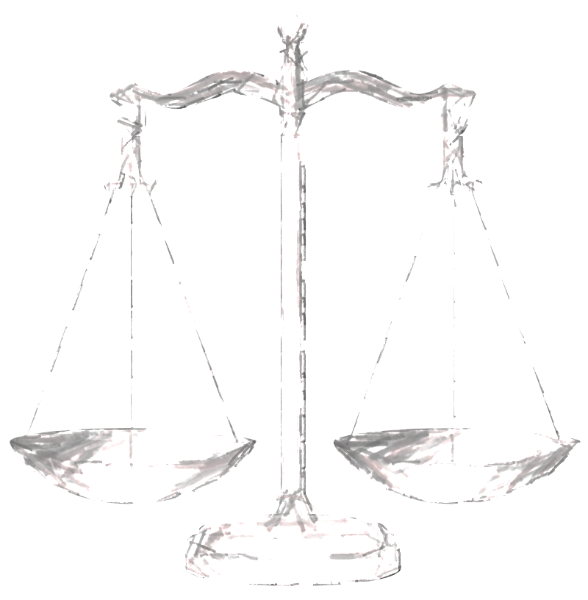
Genesis 18: 23-28
²³Abraham came near, and said, “Will you consume the righteous with the wicked? ²⁴What if there are fifty righteous within the city? Will you consume and not spare the place for the fifty righteous who are in it? ²⁵May it be far from you to do things like that, to kill the righteous with the wicked, so that the righteous should be like the wicked. May that be far from you. Shouldn’t the Judge of all the earth do right?”
²⁶Yahweh said, “If I find in Sodom fifty righteous within the city, then I will spare the whole place for their sake.”
²⁷Abraham answered, “See now, I have taken it on myself to speak to the Lord, although I am dust and ashes. ²⁸What if there will lack five of the fifty righteous? Will you destroy all the city for lack of five?”

Slide 4
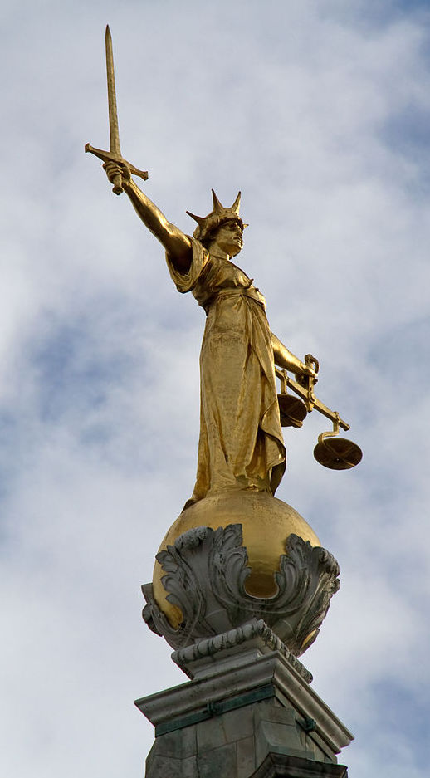
Genesis 18: 29-33
²⁹He spoke to him yet again, and said, “What if there are forty found there?”
He said, “I will not do it for the forty’s sake.”
³⁰He said, “Oh don’t let the Lord be angry, and I will speak. What if there are thirty found there?”
He said, “I will not do it if I find thirty there.”
³¹He said, “See now, I have taken it on myself to speak to the Lord. What if there are twenty found there?”
He said, “I will not destroy it for the twenty’s sake.”
³²He said, “Oh don’t let the Lord be angry, and I will speak just once more. What if ten are found there?”
He said, “I will not destroy it for the ten’s sake.”
³³Yahweh went his way as soon as he had finished communing with Abraham, and Abraham returned to his place.

Slide 5
Questions
Why does God share with Abraham his plan to destroy Sodom and Gomorrah?
As God pondered sharing his plan He said, “….that they may keep the way of Yahweh, to do righteousness and justice.” What is does this have to do with telling Abraham what He will do?
Do you think God wanted Abraham to question the destruction of Sodom and Gomorrah?

Slide 6
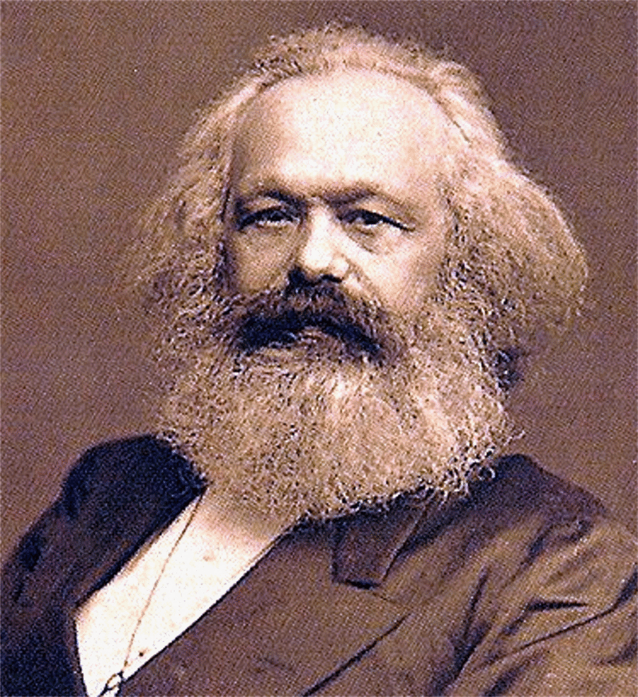
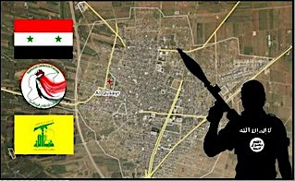
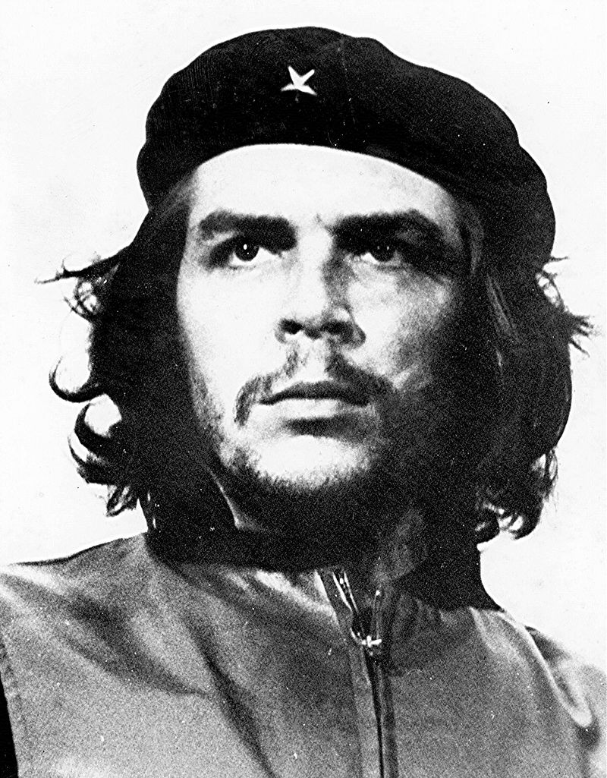
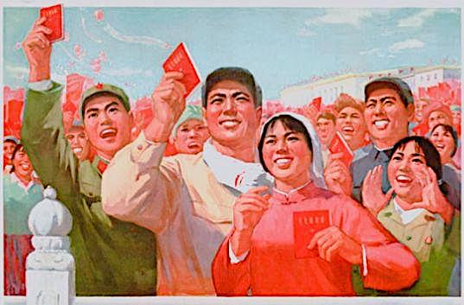
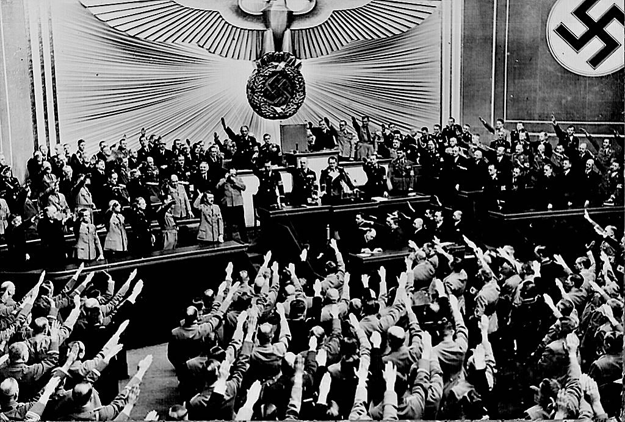
Isaiah 5:20
Woe unto them that call evil good, and good evil; that put darkness for light and light for darkness; that put bitter for sweet and sweet for bitter!

Slide 7
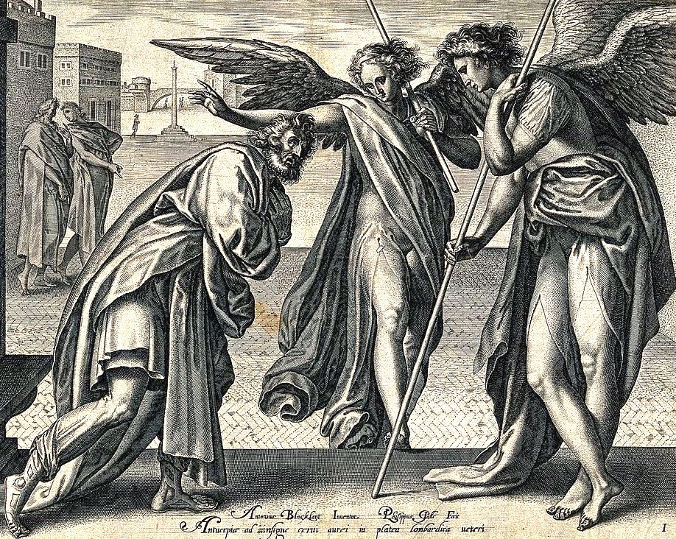
Genesis 19: 1-3
¹The two angels came to Sodom at evening. Lot sat in the gate of Sodom. Lot saw them, and rose up to meet them. He bowed himself with his face to the earth, ²and he said, “See now my lords, please come into your servant’s house, stay all night, wash your feet, rise up early, and go on your way.”
They said, “No, but we will stay in the street all night.”
³He urged them greatly and they came in with him and entered into his house. He made them a feast and baked unleavened bread and they ate.

Slide 8
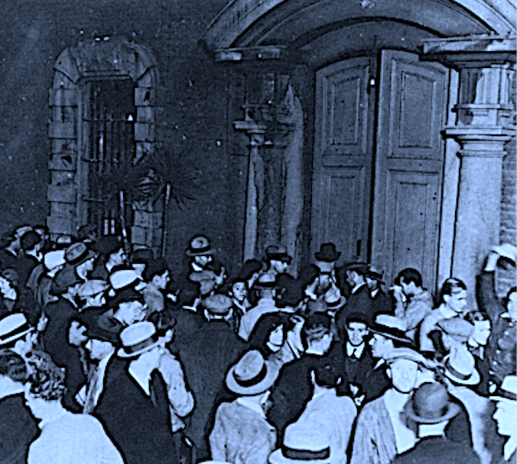
Genesis 19: 4-8
⁴But before they lay down, the men of the city of Sodom surrounded the house, both young and old, all the people from every quarter. ⁵They called to Lot and said to him, “Where are the men who came in to you this night? Bring them out to us that we may have sex with them.”
⁶Lot went out to them through the door and shut the door after himself. ⁷He said, “Please, my brothers, don’t act so wickedly. ⁸See now I have two virgin daughters. Please let me bring them out to you and you may do to them what seems good to you. Only don’t do anything to these men because they have come under the shadow of my roof.”

Slide 9
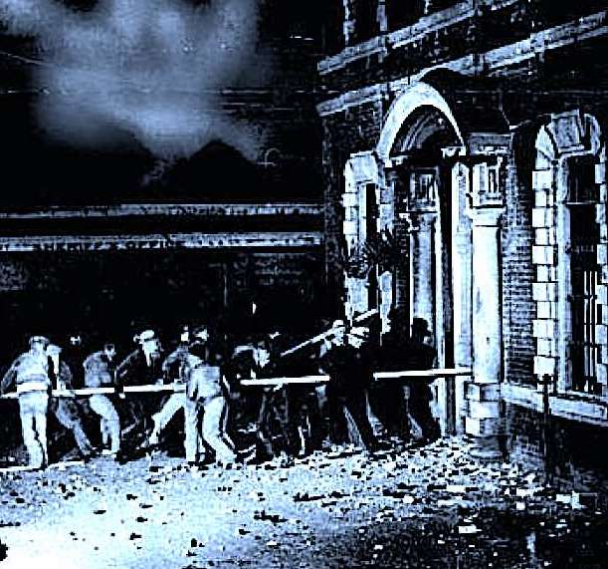
Genesis 19: 9-13
⁹They said, “Stand back!” Then they said, “This one fellow came in to live as a foreigner, and he appoints himself a judge. Now we will deal worse with you than with them!” They pressed hard on the man Lot, and came near to break the door. ¹⁰But the men reached out their hand, and brought Lot into the house to them, and shut the door. ¹¹They struck the men who were at the door of the house with blindness, both small and great so that they wearied themselves to find the door.
¹²The men said to Lot, “Do you have anybody else here? Sons-in-law, your sons, your daughters, and whomever you have in the city, bring them out of the place: ¹³for we will destroy this place, because the outcry against them has grown so great before Yahweh that Yahweh has sent us to destroy it.”

Slide 10
Questions
Why does Lot want the visitors to leave early in the morning?
Why does Lot serve them unleavened bread? What does this signify?
Lot offered his daughters to the mob outside his house. Is there any moral justification for this shocking gesture?

Slide 11
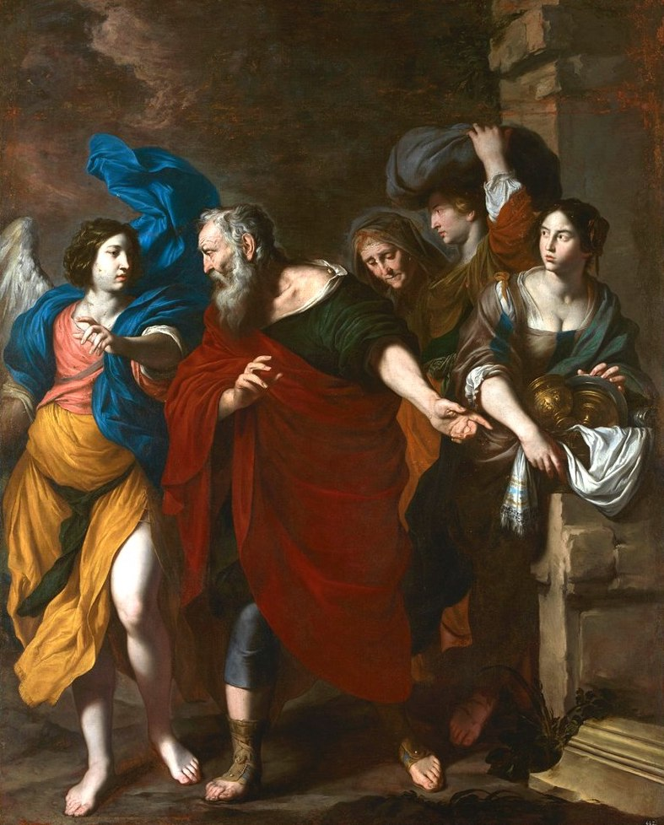
Genesis 19: 14-16
¹⁴Lot went out, and spoke to his sons-in-law, who were pledged to marry his daughters and said, “Get up! Get out of this place, for Yahweh will destroy the city!” But he seemed to his sons-in-law to be joking.
¹⁵When the morning came, then the angels hurried Lot, saying, “Get up! Take your wife and your two daughters who are here, lest you be consumed in the iniquity of the city.” ¹⁶But he lingered; and the men grabbed his hand, his wife’s hand, and his two daughters’ hands, Yahweh being merciful to him; and they took him out and set him outside of the city.

Slide 12
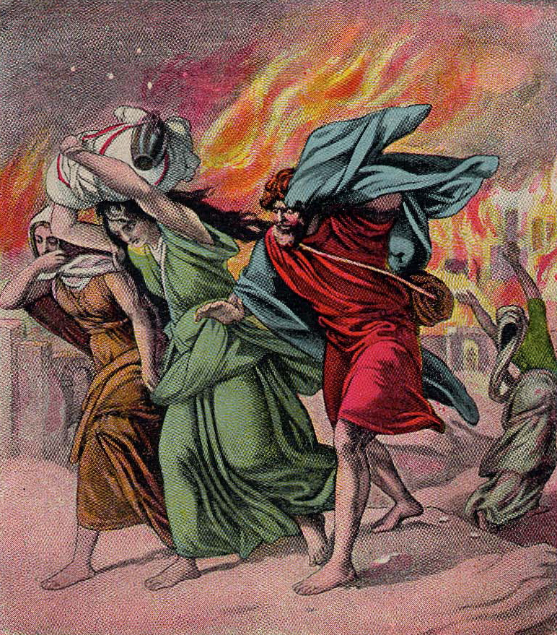
Genesis 19: 23-28
²³The sun had risen on the earth when Lot came to Zoar. ²⁴Then Yahweh rained on Sodom and on Gomorrah sulfur and fire from Yahweh out of the sky. ²⁵He overthrew those cities, all the plain, all the inhabitants of the cities, and that which grew on the ground. ²⁶But Lot’s wife looked back from behind him, and she became a pillar of salt.
²⁷Abraham went up early in the morning to the place where he had stood before Yahweh. ²⁸He looked toward Sodom and Gomorrah, and toward all the land of the plain, and saw that the smoke of the land went up as the smoke of a furnace.

Slide 13
Questions
Why did Lot hesitate? What does this indicate about his character?
Lot’s wife was turned into a pillar of salt for merely looking back. How is this harsh punishment justified?

Slide 14
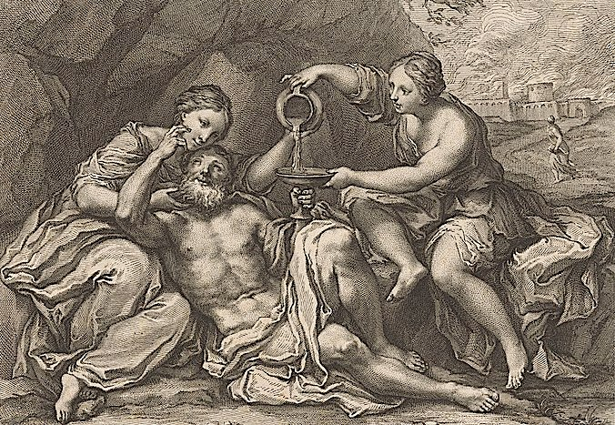
Genesis 19: 30-38
³⁰Lot went up out of Zoar, and lived in the mountain, and his two daughters with him; for he was afraid to live in Zoar. He lived in a cave with his two daughters. ³¹The firstborn said to the younger, “Our father is old, and there is not a man in the earth to give us children.
³²Come, let’s make our father drink wine, and we will lie with him, that we may preserve our father’s family line.” ³³They made their father drink wine that night: and the firstborn went in and lay with her father. He didn’t know when she lay down nor when she arose. ³⁴It came to pass on the next day that the firstborn said to the younger, “Behold, I lay last night with my father. Let’s make him drink wine again tonight. You go in, and lie with him, that we may preserve our father’s family line.” ³⁵They made their father drink wine that night also. The younger went and lay with him. He didn’t know when she lay down nor when she got up. ³⁶Thus both of Lot’s daughters were with child by their father. ³⁷The firstborn bore a son and named him Moab. He is the father of the Moabites to this day. ³⁸The younger also bore a son and called his name Ben Ammi. He is the father of the children of Ammon to this day.

Slide 15
Questions
Why did Lot’s daughters choose to have children with their father?
Who are the Moabites and Ammonites? What are their future roles in the Old Testament?

Slide 16
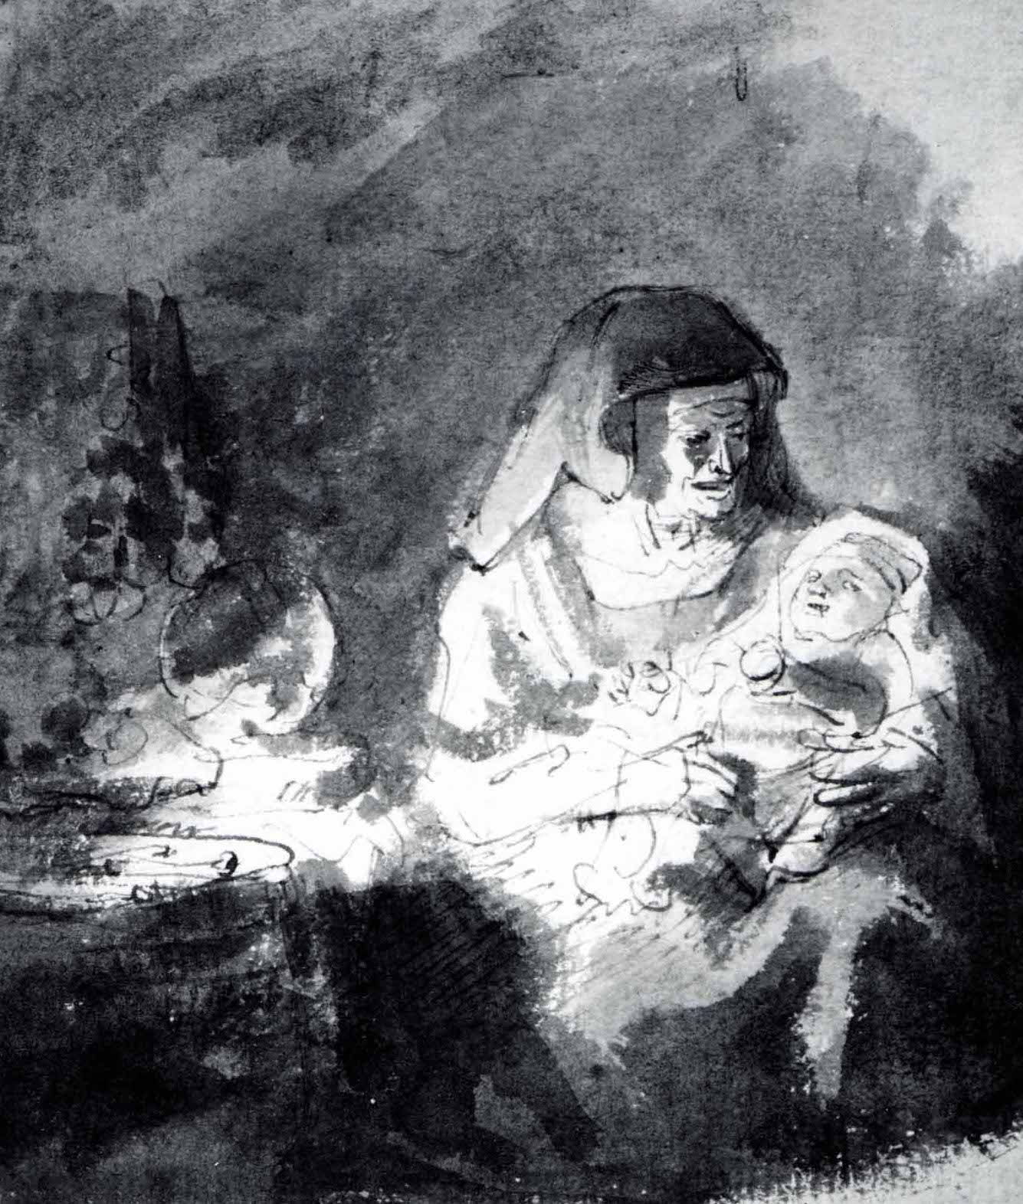
Genesis 21: 1-7
¹Yahweh visited Sarah as he had said, and Yahweh did to Sarah as he had spoken. ²Sarah conceived, and bore Abraham a son in his old age, at the set time of which God had spoken to him. ³Abraham called his son whom Sarah bore to him, Isaac. ⁴Abraham circumcised his son when he was eight days old, as God had commanded him. ⁵Abraham was one hundred years old when Isaac was born to him. ⁶Sarah said, “God has made me laugh. Everyone who hears will laugh with me.” ⁷She said, “Who would have said to Abraham that Sarah would nurse children? For I have borne him a son in his old age.”

Slide 17
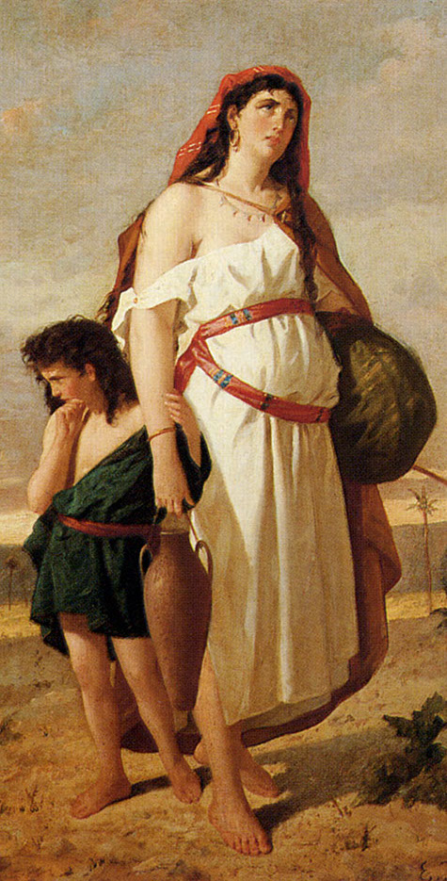
Genesis 21: 8-14
⁸The child grew and was weaned. Abraham made a great feast on the day that Isaac was weaned. ⁹Sarah saw the son of Hagar the Egyptian, whom she had borne to Abraham, mocking. ¹⁰Therefore she said to Abraham, “Cast out this servant and her son! For the son of this servant will not be heir with my son, Isaac.”
¹¹The thing was very grievous in Abraham’s sight on account of his son. ¹²God said to Abraham, “Don’t let it be grievous in your sight because of the boy and your servant. In all that Sarah says to you listen to her voice. For your offspring will be named through Isaac. ¹³I will also make a nation of the son of the servant because he is your child.” ¹⁴Abraham rose up early in the morning and took bread and a container of water and gave it to Hagar, putting it on her shoulder; and gave her the child and sent her away. She departed and wandered in the wilderness of Beersheba.

Slide 18
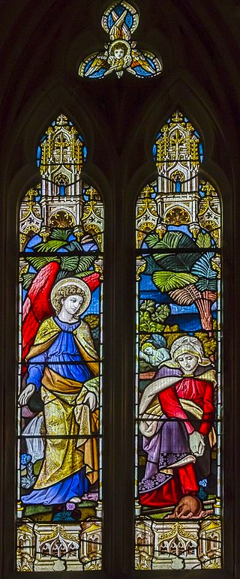
Genesis 21: 15-21
¹⁵The water in the container was spent, and she put the child under one of the shrubs. ¹⁶She went and sat down opposite him a good way off, about a bow shot away. For she said, “Don’t let me see the death of the child.” She sat opposite him and lifted up her voice and wept. ¹⁷God heard the voice of the boy.
The angel of God called to Hagar out of the sky and said to her, “What troubles you Hagar? Don’t be afraid. For God has heard the voice of the boy where he is. ¹⁸Get up, lift up the boy and hold him with your hand. For I will make him a great nation.”
¹⁹God opened her eyes and she saw a well of water. She went filled the container with water and gave the boy a drink.
²⁰God was with the boy and he grew. He lived in the wilderness and as he grew up he became an archer. ²¹He lived in the wilderness of Paran. His mother got a wife for him out of the land of Egypt.

Slide 19
Questions
Why did Abraham concede to Sarah’s request to expel Hagar and Ishmael?
Why did God concur with Sarah’s request to expel Hagar and Ishmael?
How did God compensate Hagar and Ishmael for this unfair treatment?

Slide 20
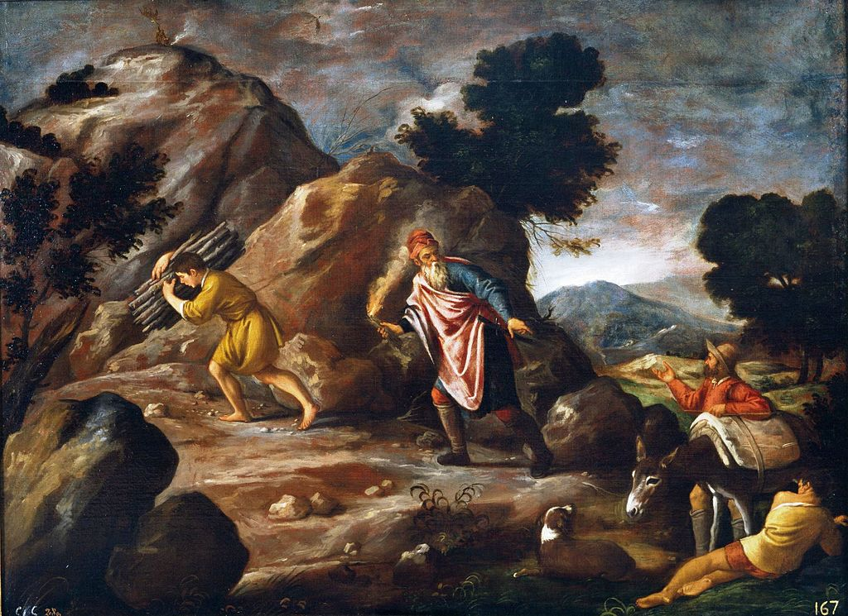
Genesis 22: 1-5
¹After these things, God tested Abraham, and said to him, “Abraham!”
He said, “Here I am.”
²He said, “Now take your son Isaac, whom you love, and go into the land of Moriah. Offer him there as a burnt offering on one of the mountains which I will tell you of.”
³Abraham rose early in the morning, and saddled his donkey; and took two of his young men with him, and Isaac his son. He split the wood for the burnt offering, and rose up, and went to the place of which God had told him. ⁴On the third day Abraham lifted up his eyes, and saw the place far off. ⁵Abraham said to his young men, “Stay here with the donkey. The boy and I will go over there. We will worship, and come back to you.”

Slide 21
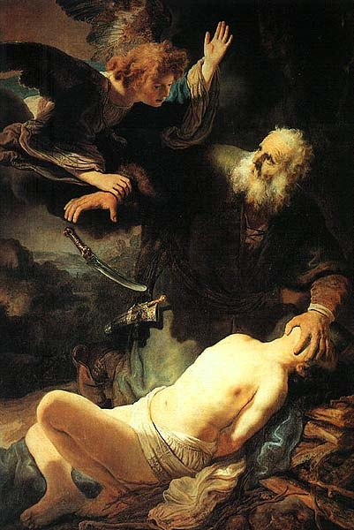
Genesis 22: 6-11
⁶Abraham took the wood of the burnt offering and laid it on Isaac his son. He took in his hand the fire and the knife. They both went together. ⁷Isaac spoke to Abraham his father, and said, “My father?”
He said, “Here I am, my son.”
He said, “Here is the fire and the wood, but where is the lamb for a burnt offering?”
⁸Abraham said, “God will provide himself the lamb for a burnt offering my son.” So they both went together. ⁹They came to the place which God had told him of. Abraham built the altar there, and laid the wood in order, bound Isaac his son and laid him on the altar on the wood. ¹⁰Abraham stretched out his hand, and took the knife to kill his son.
¹¹Yahweh’s angel called to him out of the sky and said, “Abraham, Abraham!”
He said, “Here I am.”

Slide 22
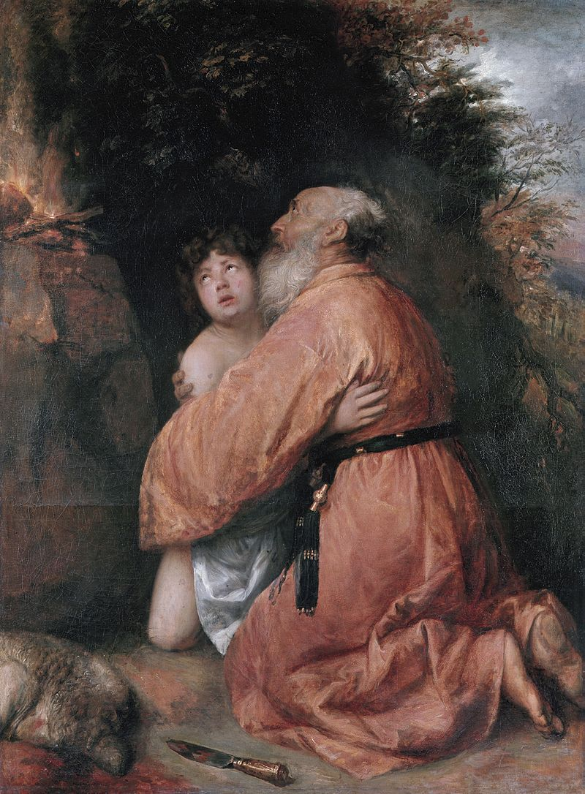
Genesis 22: 12-14
¹²He said, “Don’t lay your hand on the boy or do anything to him. For now I know that you fear God, since you have not withheld your only son from me.”
¹³Abraham lifted up his eyes, and looked and saw that behind him was a ram caught in the thicket by his horns. Abraham went and took the ram and offered him up for a burnt offering instead of his son. ¹⁴Abraham called the name of that place “Yahweh Will Provide”. As it is said to this day, “On Yahweh’s mountain, it will be provided.”

Slide 23
Questions
God destroyed the cities of Sodom and Gomorrah for their wickedness and Abraham questioned the harshness of God’s judgement. Compare this with Abraham’s response to God’s order to sacrifice Isaac. How are they different?
Why didn’t Abraham question this incredibly shocking request?

Slide 24
Acknowledgments:
Scripture verses were taken from the World English Bible and edited for clarity.
Unless otherwise indicated, all images were downloaded from Wikimedia.
Most of the questions are derived from commentary from “The Rational Bible: Genesis” by Dennis Prager.

